Slide 1
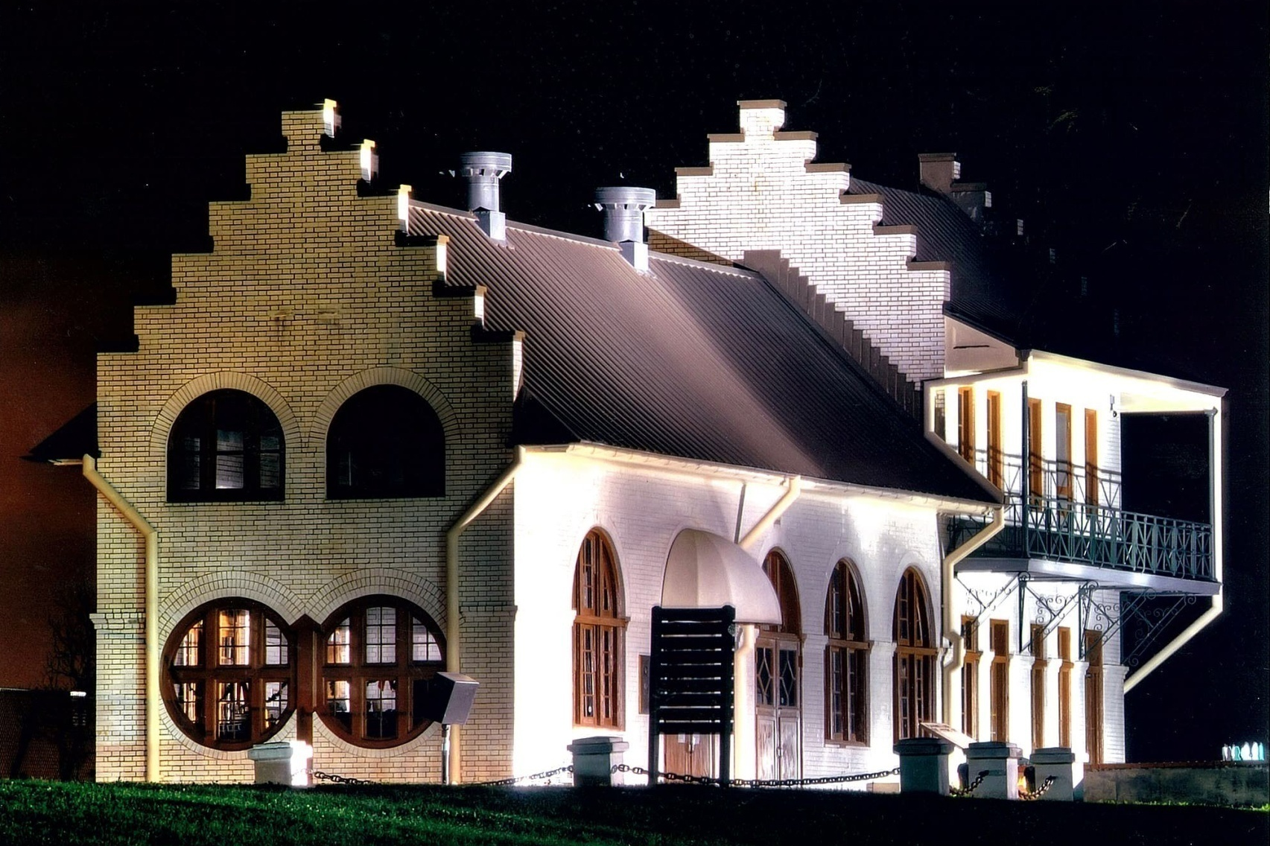
History of the Gary J. Hebert Memorial Lockhouse from 1961-2012 and
Bayou Plaquemine Waterfront Park from 1990s to 2012
Plaquemine Lock State Historic Site
Notes:
Many times throughout our lives, we’re reminded that when one door shuts, it makes way for another one to open.
For many years, people took for granted that the Lock would always be a centerpiece for the City of Plaquemine. Maybe that’s why just over 50 years ago, it came as a shock to many that the U.S. Army Corps of Engineers chose to close the Lock. That alone was hard to accept. The passing of boats through the Lock had become a way of life since 1909.
What was even worse was the aftermath of the closing. A decade had elapsed since its closure, and now it had become the target of a full-scale destruction in favor of highway expansion. My husband, the late Gary J. Hebert, along with many others in the community, saw this plan as a threat to the identity of Plaquemine. Imagine if they’d have demolished St. John the Evangelist Church, the Old City Hall or the original courthouse.
We were proud of our history, and saw the preservation of this beautiful area as a means of uniting the past, the present, and the future. It was through years of efforts and hardships that we were able to halt the demolition plans and bring new life to the Lock.
We’ve leaped many hurdles to get where we are today. While the Lock isn’t used for its purpose prior to this day in 1961, we’ve proven that it’s anything but dead. This area has become a highly recognizable example of our history as a river town. It has also become the centerpiece for many activities in our community. The efforts of government and civic groups have now ensured a very bright future for the Lock.
We have seen the opening of another door – one that will lead us to many more years to cherish this gift Plaquemine has enjoyed for more than a century.

Slide 2
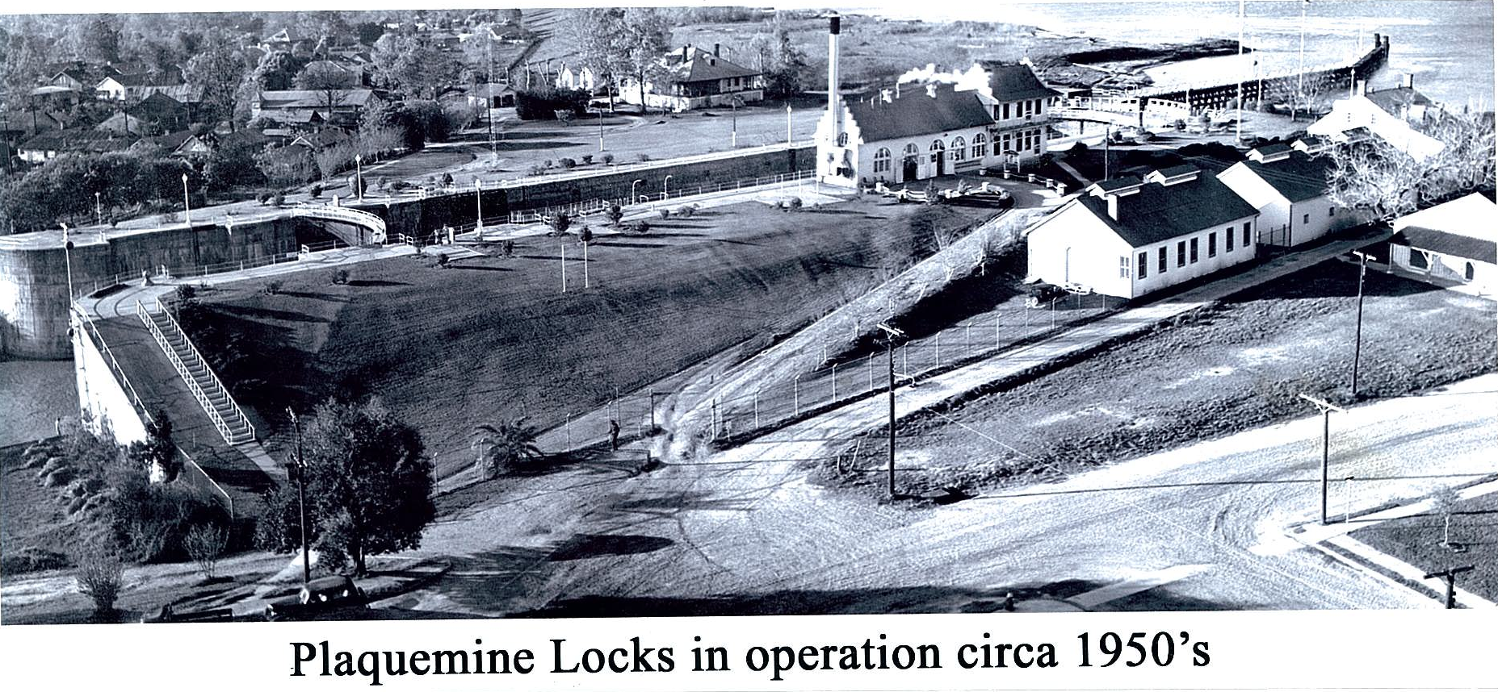
This photo of the Plaquemine Lock in full operation was taken by the late Gary Hebert from the St. John Church steeple in the early 1950’s. The Lock was designed by Col. George Goethals, who later designed the Panama Canal. The Lock ceased functioning when the Port Allen Lock was opened to water traffic on July 14, 1961.
Notes:
This photo of the Plaquemine Lock in full operation was taken by the late Gary Hebert from the St. John Church steeple in the early 1950’s. The Lock was designed by Col. George Goethals, who later completed the design of the Panama Canal. The Lock ceased functioning when the Port Allen Lock was opened to water traffic on July 14, 1961.

Slide 3

The Lock is closed to navigation.
Notes:
The Lock is closed to navigation.

Slide 4
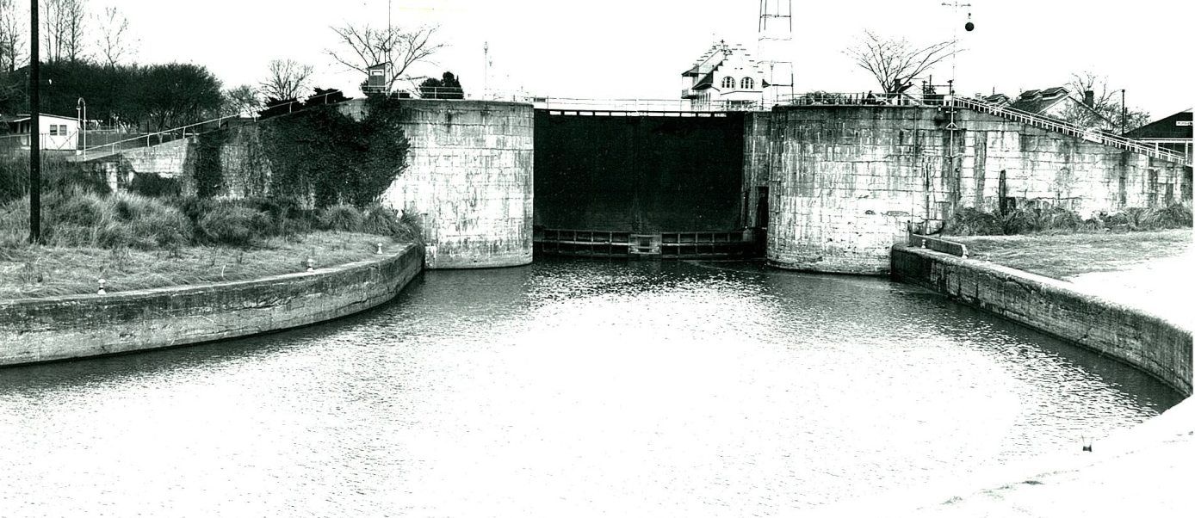
Early 1960s
The Lock in the early 1960s, after it was closed to navigation. The Lock structure was judged to be inadequate in 1954 and a new lock structure was built in Port Allen.
Notes:
The Lock in the early 1960s after it was closed to navigation. The Lock structure was judged to be inadequate in 1954 and a new lock structure was built in Port Allen.

Slide 5
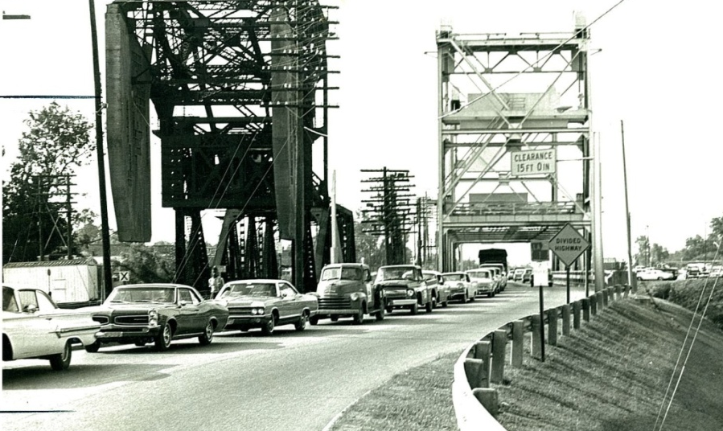
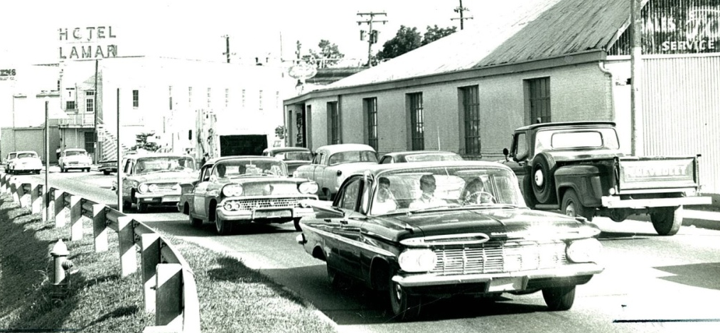
October 13, 1966
Traffic problems at Bayou Plaquemine bridge
The Louisiana Department of Highways let a contract for the four-lane expansion of La. 1 from Port Allen to Plaquemine in July, 1966. Monumental traffic jams developed as the two-lane bridge at the La. 1 artery through the city could not handle the traffic.
Notes:
The Louisiana Department of Highways let a contract for the four-lane expansion of La. 1 from Port Allen to Plaquemine in July, 1966. With the influx of industry and residents, monumental traffic jams developed as the two-lane bridge and the La. 1 artery through the city could not handle the internal and through traffic.

Slide 6
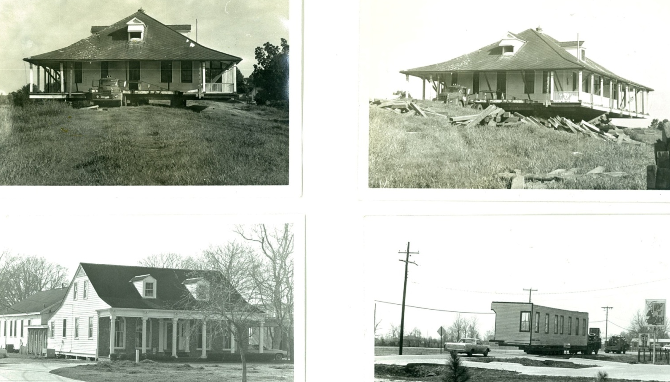
1966 - 1967
The Lockmaster’s house, top photos, and Assistant Lockmaster’s House, lower photos, were sold by the U.S. Army Corps of Engineers. The Lockmaster’s house was purchased by Kirkland Doiron and rolled on the levee to Brusly. It is now the home of Roger and Lisa Daggett. The Assistant Lockmaster’s House was purchased by the late Dr. Carl Blunck, who moved it to Belleview Road for his medical office.
Notes:
The Lockmaster’s house, top photos, and Assistant Lockmaster’s House, lower photos, were sold by the U.S. Army Corps of Engineers. The Lockmaster’s house was purchased by Kirkland Doiron and rolled on the levee to Brusly. It is now the home of Roger and Lisa Daggett. The Assistant Lockmaster’s House was purchased by the late Dr. Carl Blunck who moved it to Belleview Road for his medical office.

Slide 7
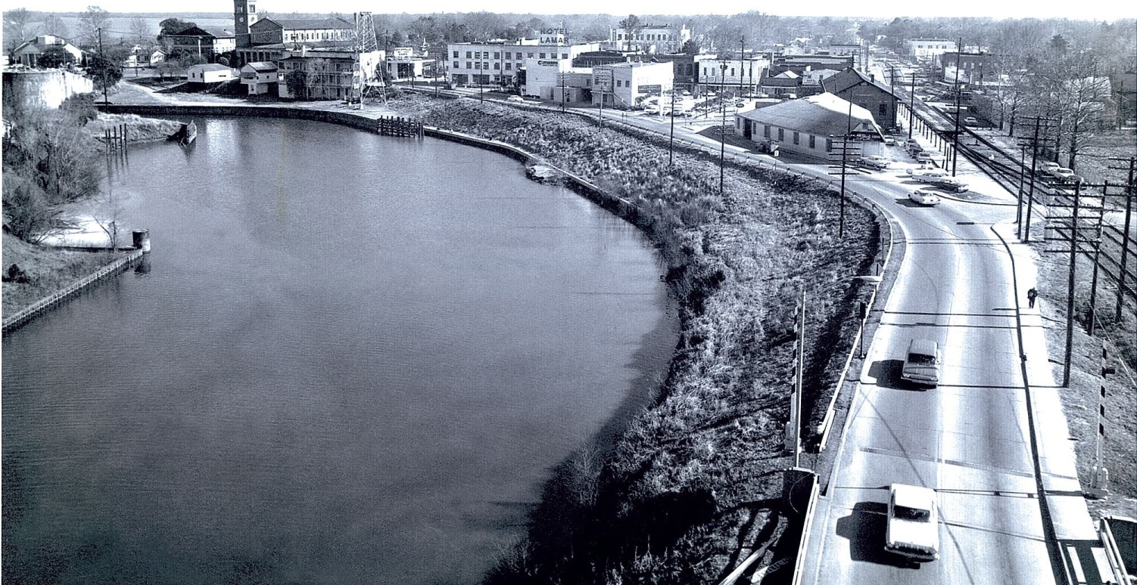
1960s & early 1970s
In the late 1960s the La. Highway Department presented a plan to fill in 1,500 feet of Bayou Plaquemine and tear down the Lock building for a 4-lane extension of La. 1. Gary Hebert, historian and preservationist, and editor of the Plaquemine POST, vehemently disagreed with the highway plans and formed “Save Bayou Plaquemine, Inc.” to fight the project. This photo shows Highway 1 at that time.
Notes:
In the late 1960s the Highway Department presented a plan that called for filling in 1,500 feet of Bayou Plaquemine and tearing down the Lock building. On this foundation a four-lane extension of La. 1 would be constructed to connect with Eden and Church Streets. Gary Hebert, historian and preservationist, and editor of the Plaquemine POST, vehemently disagreed with the highway plans and formed “Save Bayou Plaquemine, Inc.” to fight the project. This photo shows Highway 1 at that time.

Slide 8

The fight to save Bayou Plaquemine and the Lock

Slide 9
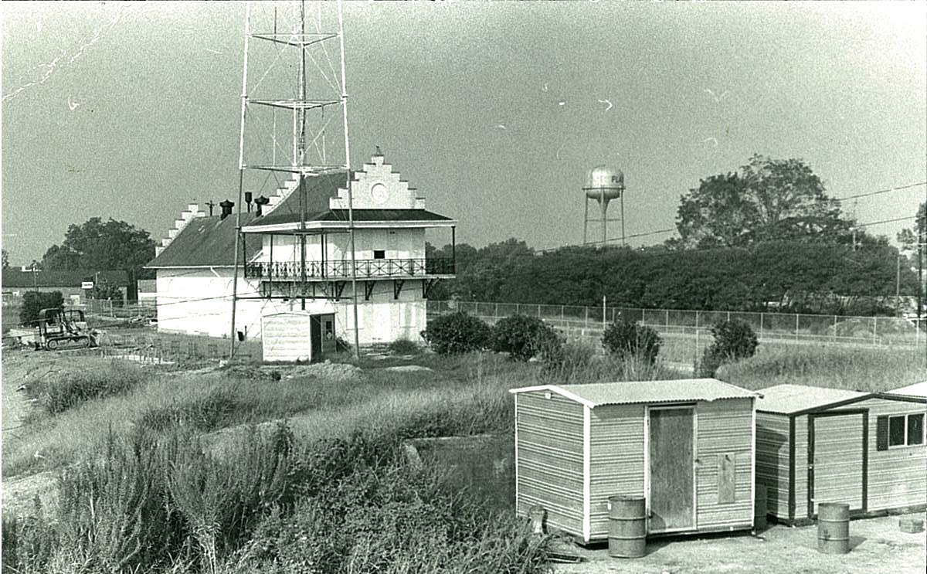
Late 1970s
The Lockhouse was boarded up in Sept. 1961 and remained boarded in the 1960’s and 1970’s before it was renovated into a museum.
Notes:
The Lock was closed and boarded up in September 1961 and remained boarded in the 1960’s and 1970’s before it was renovated into a museum.

Slide 10
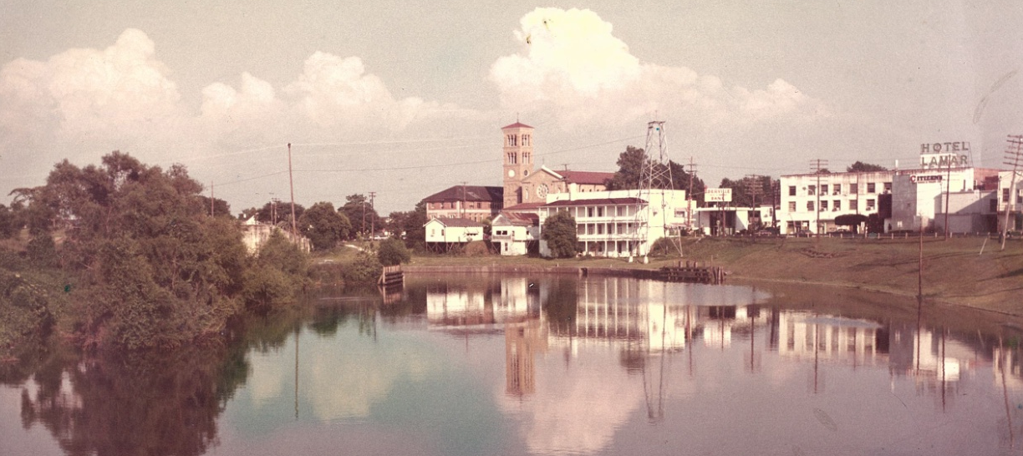
April 1971
Photo of Bayou Plaquemine taken by Gary Hebert in April 1971. This photo shows the Lamar Hotel, the Elks Building, which also housed Lindsey Furniture; A. K. Grace Insurance, Dr. Alvery Richard’s Office and later Banta Towing Co. These buildings were demolished to make way for the new highway.
Notes:
Photo of Bayou Plaquemine taken by Gary Hebert in April 1971. This photo shows the Lamar Hotel, the Elks Building which also housed Lindsey Furniture, A. K. Grace Insurance, Dr. Alvery Richard’s Office and later BantaTowing Company. These buildings were demolished to make way for the new highway.

Slide 11
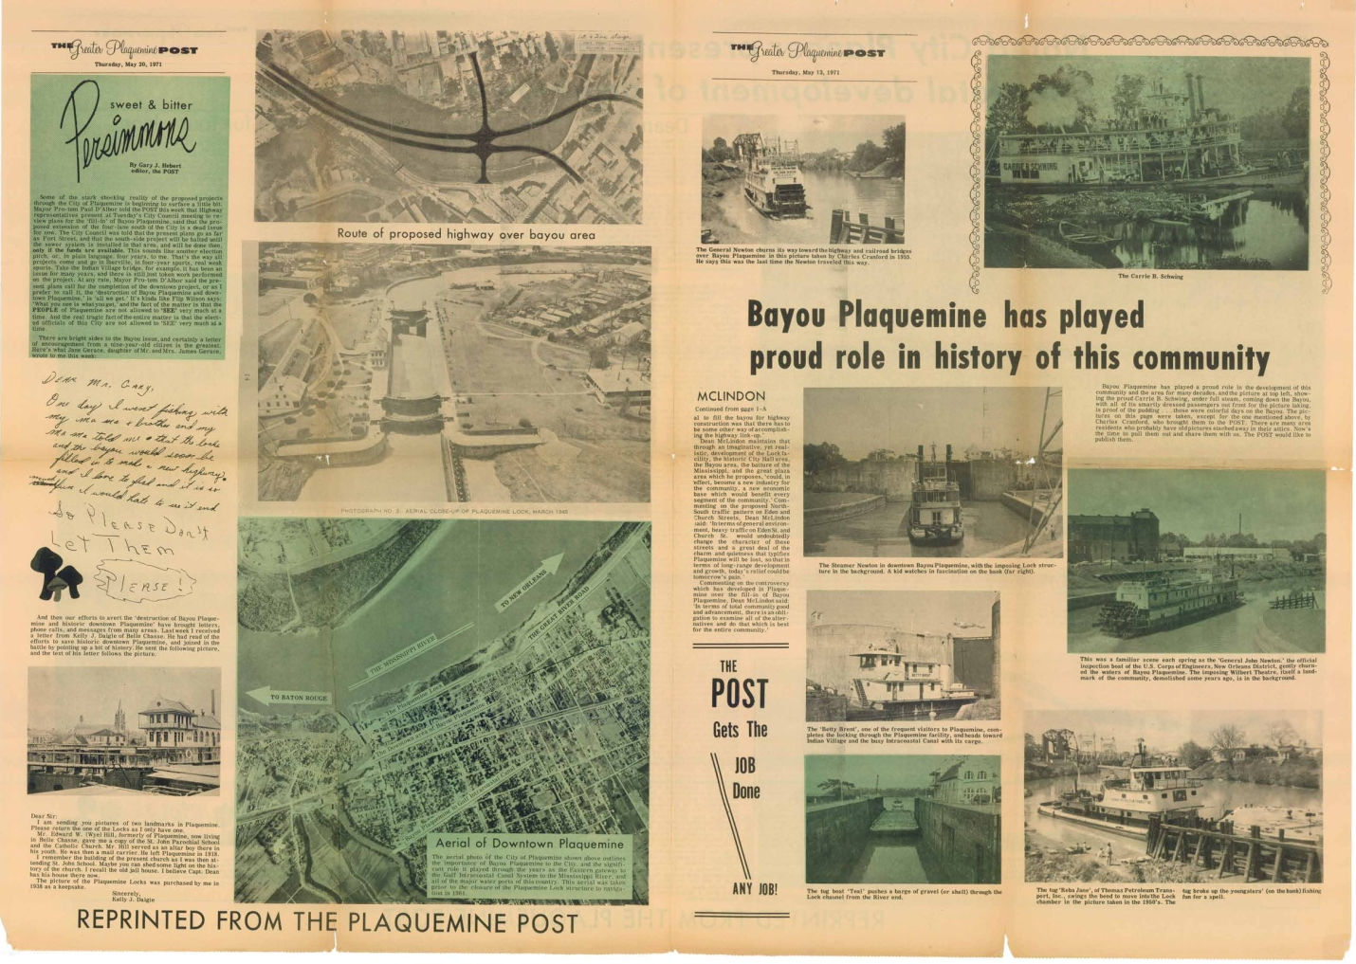
May 1971
This newspaper spread in May 1971 was typical of the historic information printed in the Plaquemine POST showing the importance of Bayou Plaquemine to this area.
Notes:
This newspaper spread in May 1971 was typical of the historic information printed in the Plaquemine POST showing the importance of Bayou Plaquemine to this area.

Slide 12
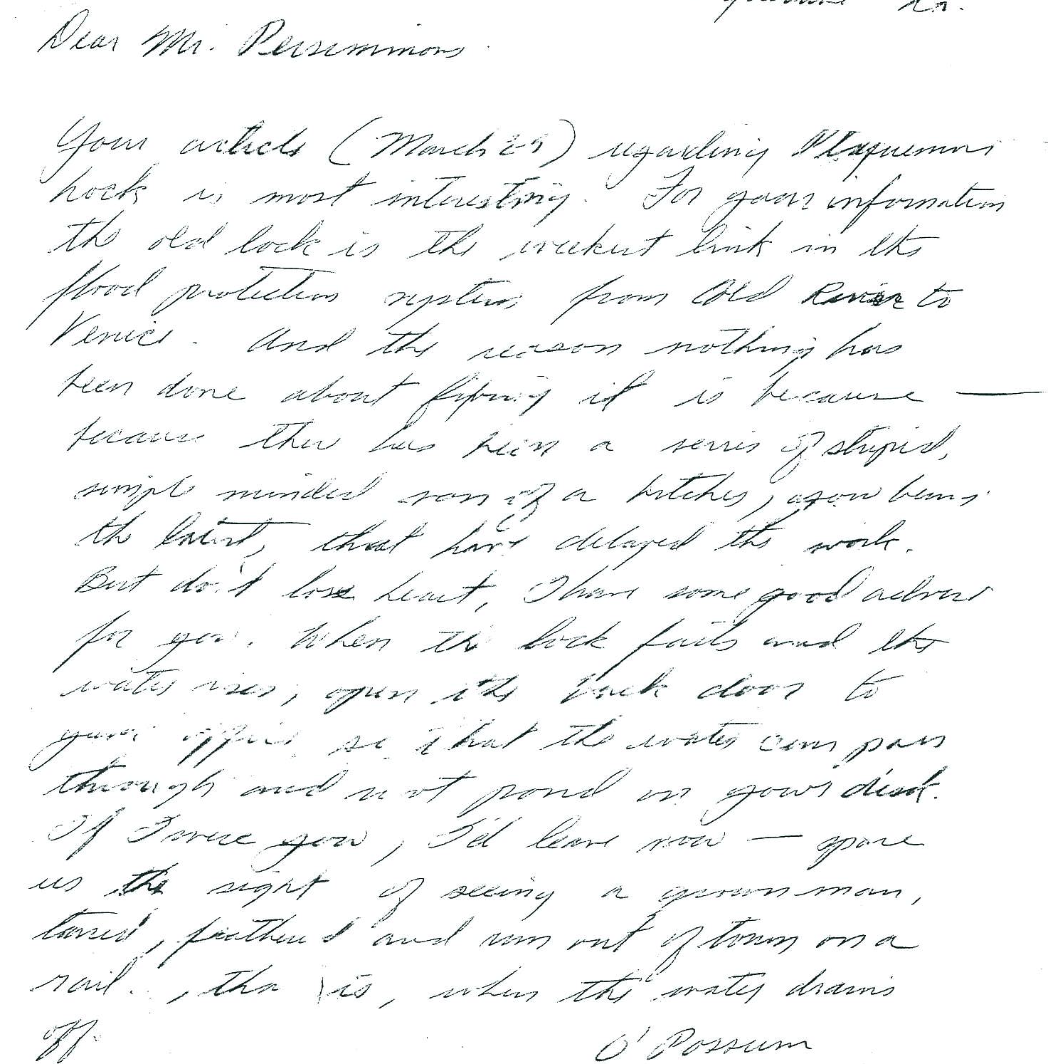
1971
Opposition letter to Hebert’s fight to save the Lock
Gary Hebert’s fight to save the Lock became heated in 1971. He contacted local, state and national officials in support of his efforts. He began receiving letters of opposition. One letter from “Opossum”, a person who would not give his name, stated, in part: “When the lock falls and the water rises, open the back door to your office so that the water can pass through and not pond on your desk. If I were you, I’d leave now – spare us the sight of seeing a grown man tarred, feathered, and run out of town on a rail, that is, when the water drains off.”
Notes:
Gary Hebert’s fight to save the Lock became heated in 1971. He contacted local, state and national officials in support of his efforts. He began receiving letters of opposition. One letter from “Opossum”, a person who would not give his name, stated, in part: “When the lock falls and the water rises, open the back door to your office so that the water can pass through and not pond on your desk. If I were you, I’d leave now – spare us the sight of seeing a grown man tarred, feathered, and run out of town on a rail, that is, when the water drains off.

Slide 13
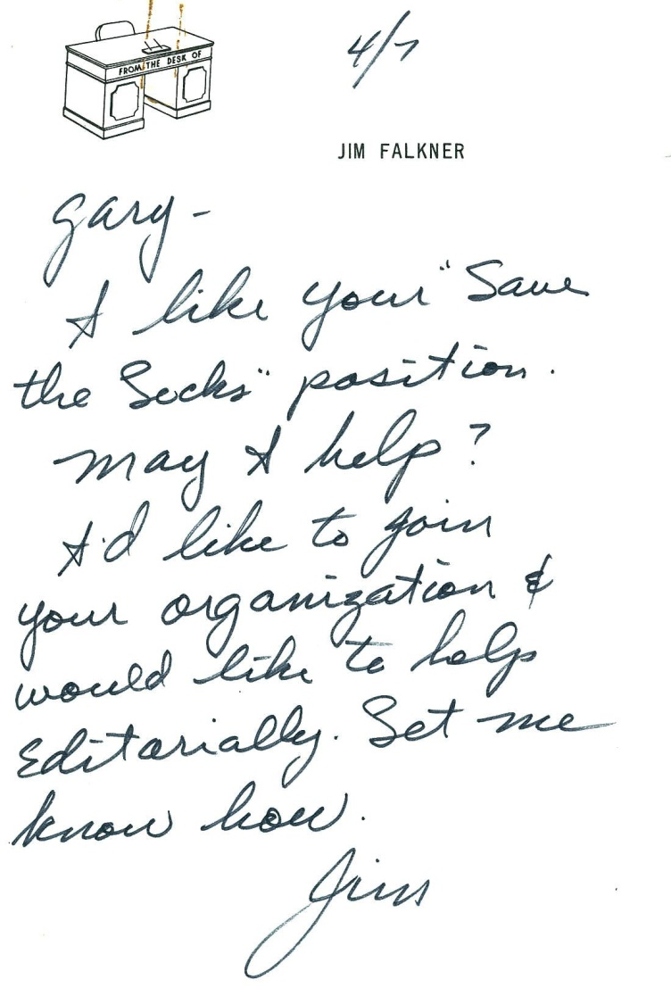
April 7, 1971
Support for the Lock
This is a typical letter of support. These were mostly from out-of-town people who appreciated the beauty of the area and did not want it destroyed.
Notes:
This is a typical letter of support. These were mostly from out-of-town people who appreciated the beauty of the area and did not want it destroyed.

Slide 14
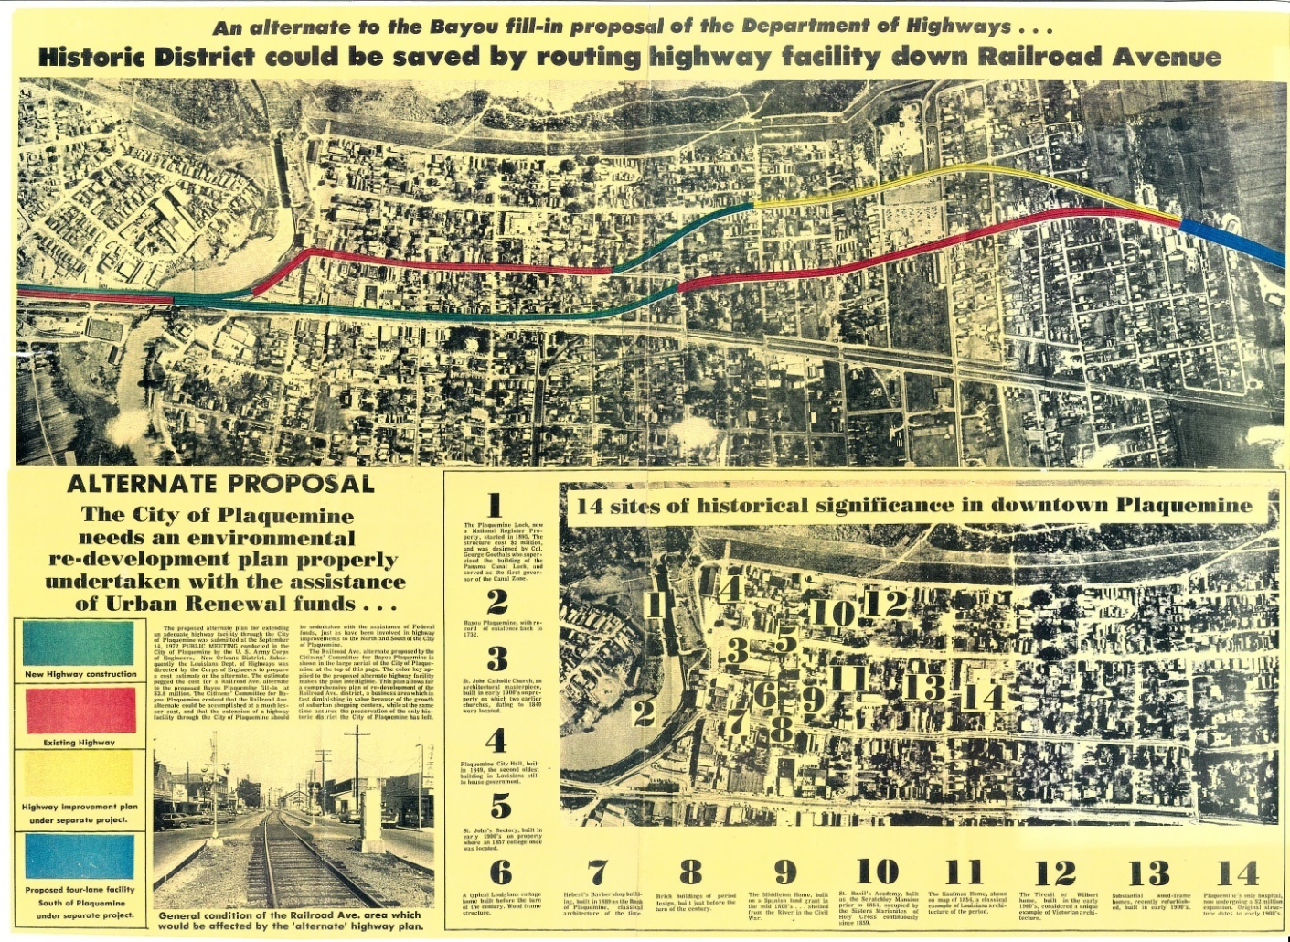
1972
Gary Hebert published another alternate route for the highway in the Plaquemine POST in 1972. He worked tirelessly for several years, in spite of losing advertising, to save the Lock from demolition.
Notes:
Gary Hebert published another alternate route for the highway in the Plaquemine POST in 1972. He worked tirelessly for several years, in spite of losing advertising, to save the Lock from demolition.

Slide 15
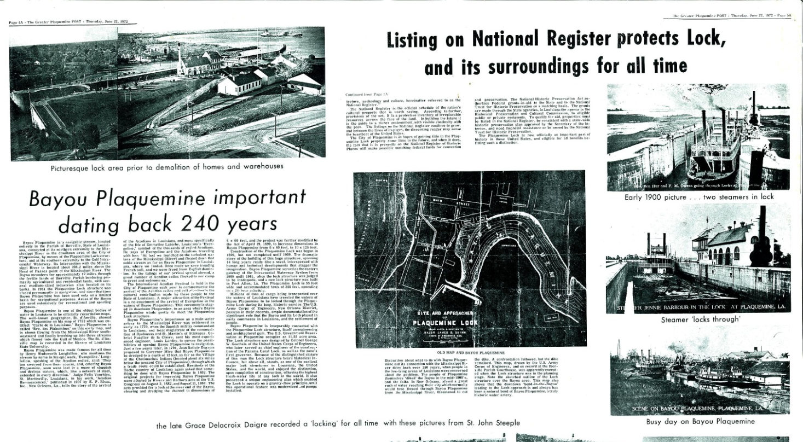
June 22, 1972
Gary Hebert, with the assistance of Jared Bradley, Director of the Louisiana Historical Preservation and Cultural Commission, submitted the nomination for the Lock property to be placed on the National Register of Historic Places. The Lock was accepted and placed on the National Register in June, 1972. This designation saved the Lock structures from demolition. The engineers at the Louisiana Department of Highways then came up with plans for the highway to wrap around Bayou Plaquemine, as it is today.
Notes:
Gary Hebert, with the assistance of Jared Bradley, Director of the Louisiana Historical Preservation and Cultural Commission, submitted the nomination for the Lock property to be placed on the National Register of Historic Places. The Lock was accepted and placed on the National Register in June, 1972. This designation saved the Lock structures from demolition. The engineers at the Louisiana Department of Highways then came up with plans for the highway to wrap around Bayou Plaquemine, as it is today.

Slide 16
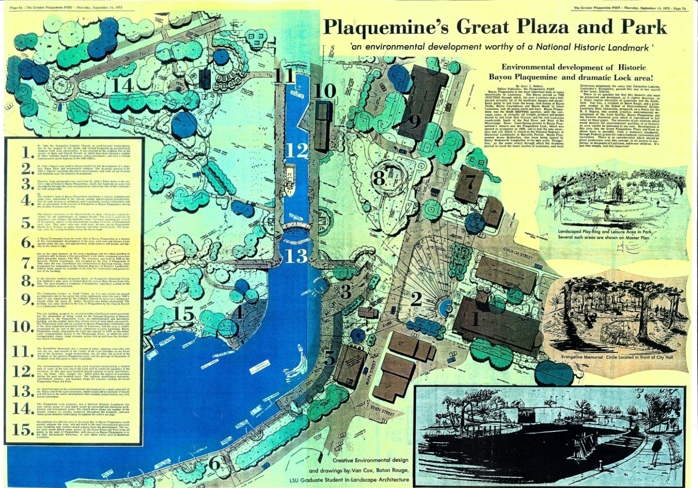
September 14, 1972
The Lock fight went on for several years. Gary Hebert enlisted the help of Gerald J. McLindon, Dean of the LSU School of Environmental Design, in early 1971. This proposal, designed by Van Cox, an LSU graduate student in Landscape Architecture, was published September 14, 1972.
Notes:
The Lock fight went on for several years. Gary Hebert enlisted the help of Gerald J. McLindon, Dean of the LSU School of Environmental Design, in early 1971. This proposal, designed by Van Cox, an LSU graduate student in Landscape Architecture, was published September 14, 1972.

Slide 17
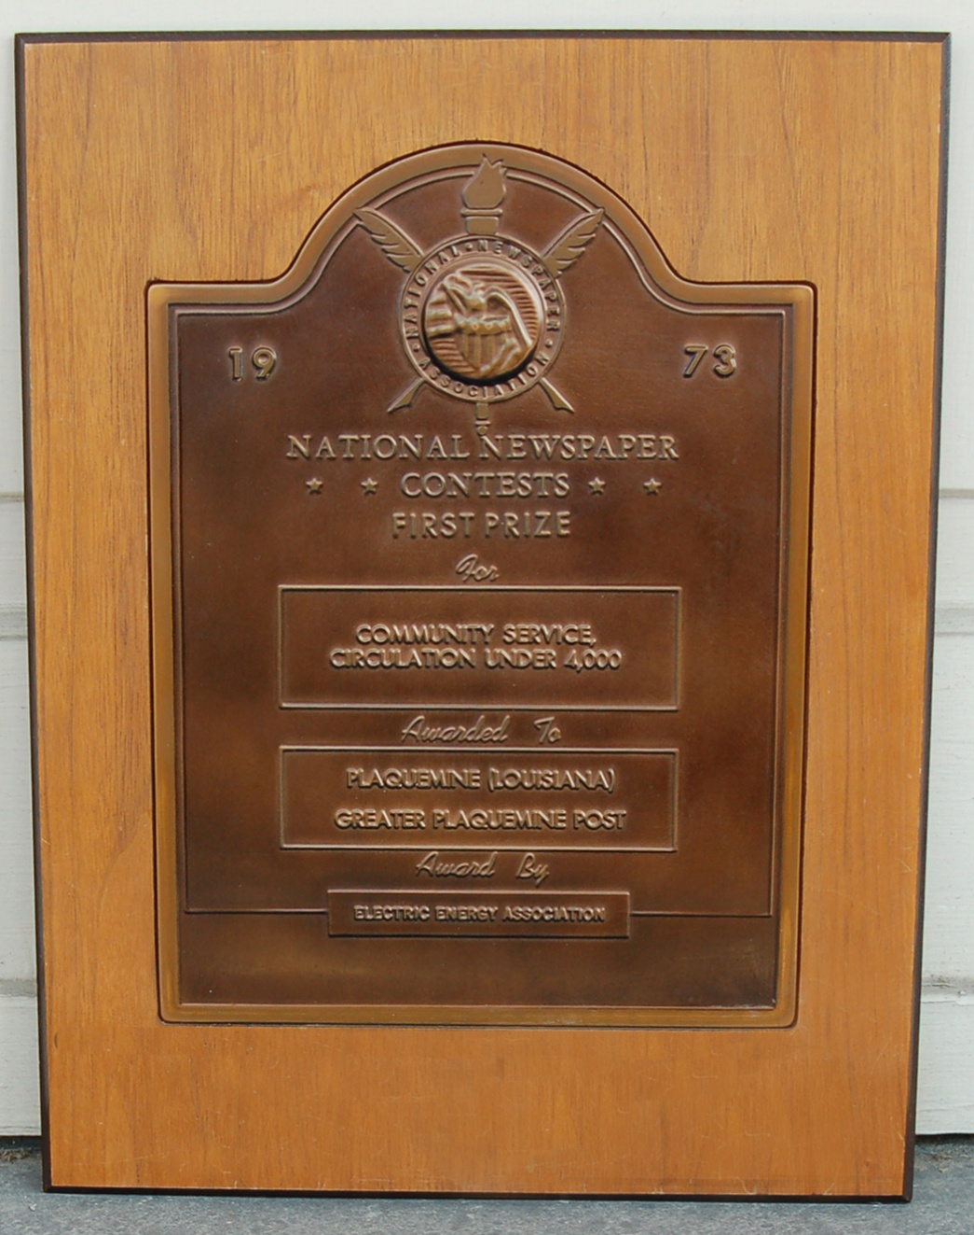
1973
The Plaquemine POST won the National Newspaper Association Community Service Award in 1973 for its years-long struggle to save the Plaquemine Lock and Bayou Plaquemine.
Notes:
The Plaquemine POST won the National Newspaper Association Community Service Award in 1973 for its years-long struggle to save the Plaquemine Lock and Bayou Plaquemine.

Slide 18
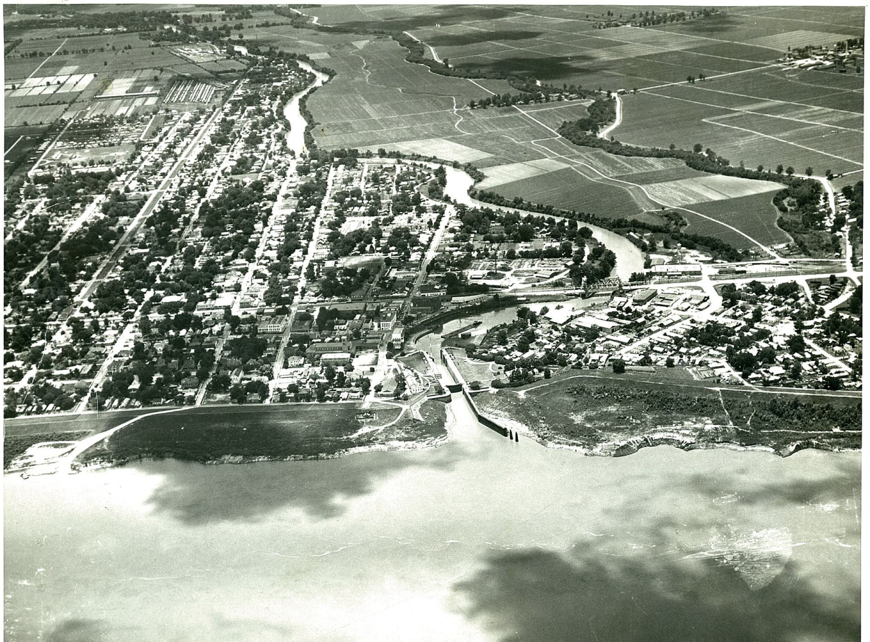
1973
This aerial view of the Lock and the City of Plaquemine was taken in 1973 prior to the closure of the Mississippi River end of Bayou Plaquemine.
Notes:
This aerial view of the Lock and the City of Plaquemine was taken in 1973 prior to the closure of the Mississippi River end of Bayou Plaquemine.

Slide 19
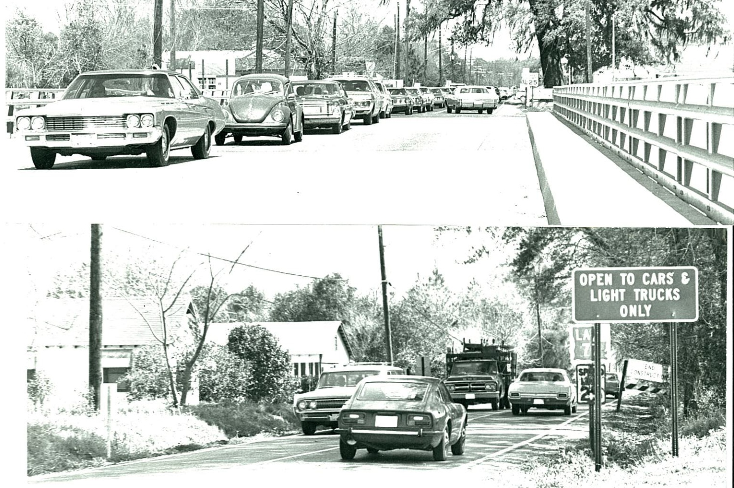
1973
Traffic bottlenecks continued in downtown Plaquemine through the 1970’s. It took years for the Louisiana Department of Highways to complete plans for the bridge at Bayou Plaquemine, and to move the traffic south on Eden Street and north on Church Street, as it flows today.
Notes:
Traffic bottlenecks continued in downtown Plaquemine through the 1970’s. It took years for the Louisiana Department of Highways to complete plans for the bridge at Bayou Plaquemine, and to move the traffic south on Eden Street and north on Church Street, as it flows today.

Slide 20
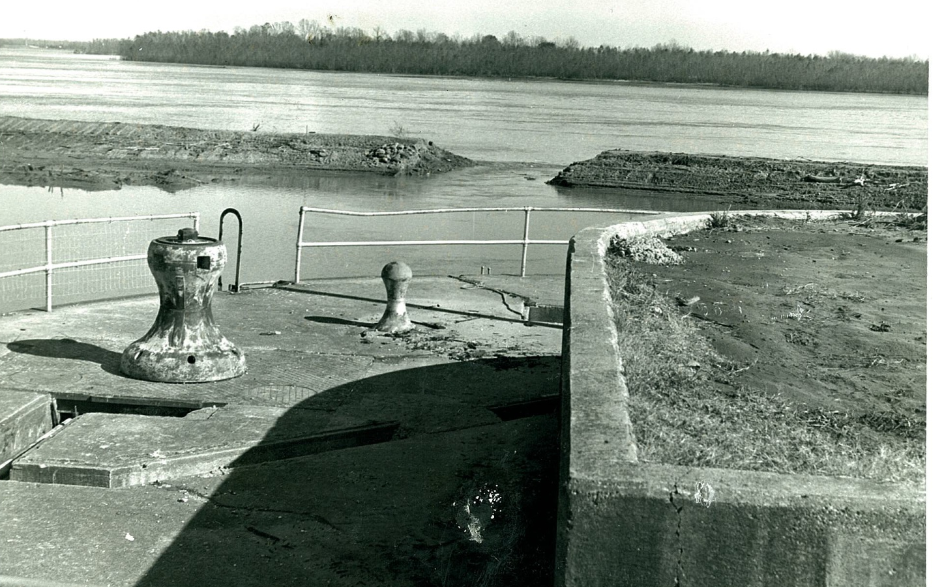
1973
The high water in the Mississippi in the spring and summer of 1973 threatened levees throughout the state. Gary Hebert was accused of holding up the building of the earthen levee beyond the lock and endangering Plaquemine with flooding should the lock structure give out. Severe criticism of Hebert ended only when the river was stabilized later in the year. This photo shows the failure of the temporary levee in May.
Notes:
The high water in the Mississippi in the spring and summer of 1973 threatened levees throughout the state and in the area. Gary Hebert was accused of holding up the building of the earthen levee beyond the lock and endangering the City of Plaquemine and the area with flooding should the lock structure give out. Severe criticism of Hebert ended only when the river was stabilized later in the year. This photo shows the failure of the temporary levee in May.

Slide 21
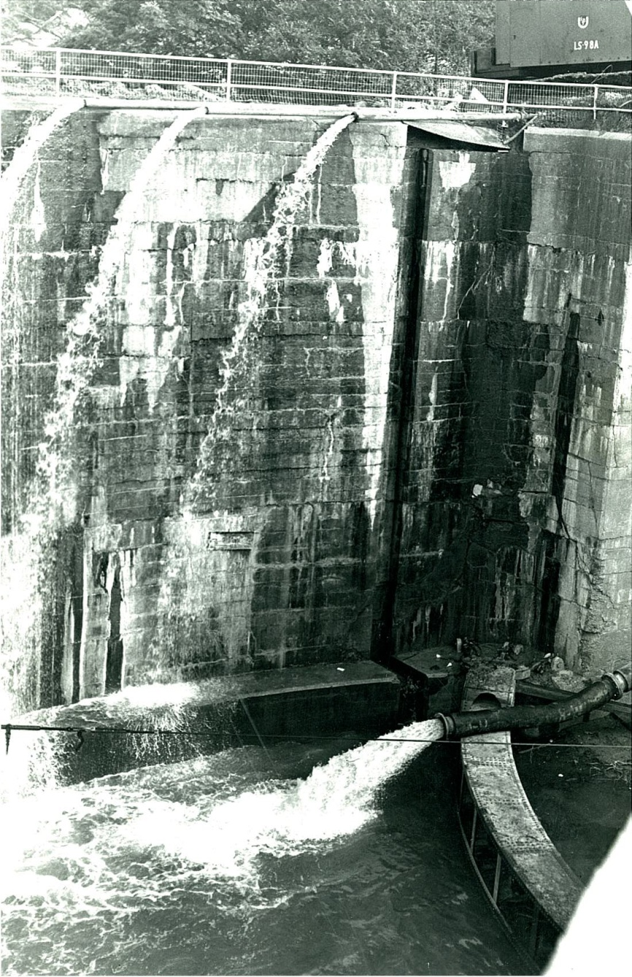
1973
Water was pumped from the Lock chamber into Bayou Plaquemine to relieve pressure from high water in 1973.
Notes:
Water was pumped from the Lock chamber into Bayou Plaquemine to relieve pressure from high water in 1973.

Slide 22
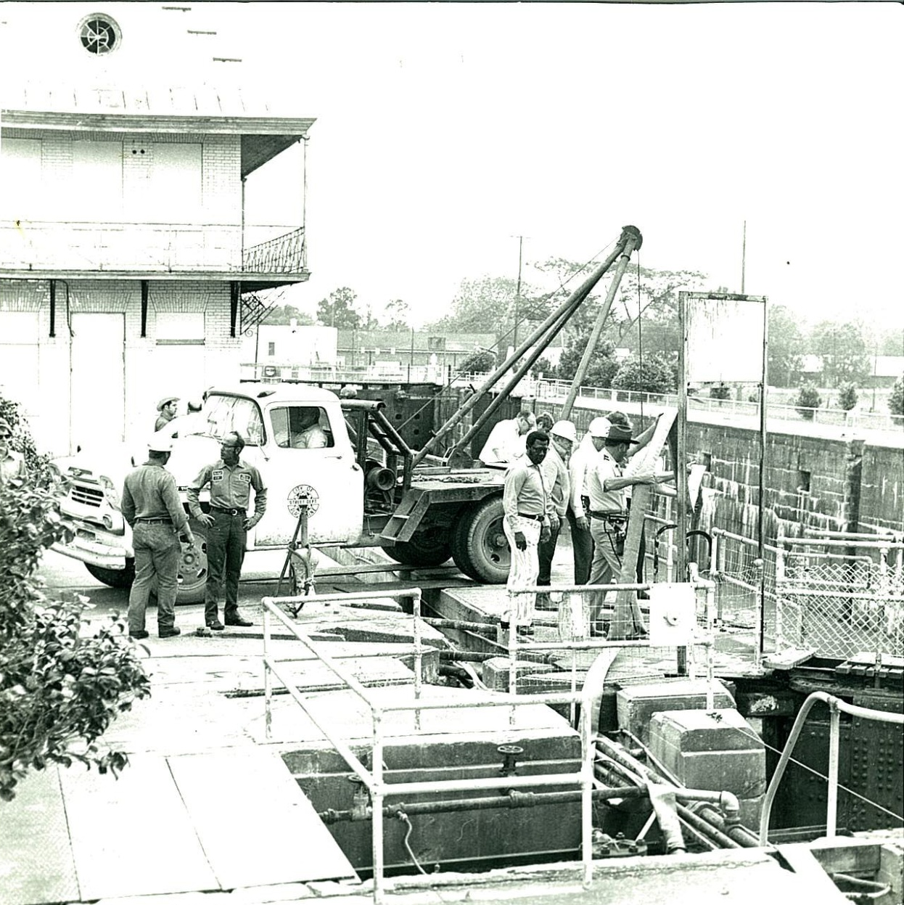
1973
The problem with the high water in 1973 was serious, and the U.S. Army Corps of Engineers came in to inspect the Lock during the crisis.
Notes:
The problem with the high water in 1973 was serious, and the U.S. Army Corps of Engineers came in to inspect the Lock during the crisis.

Slide 23
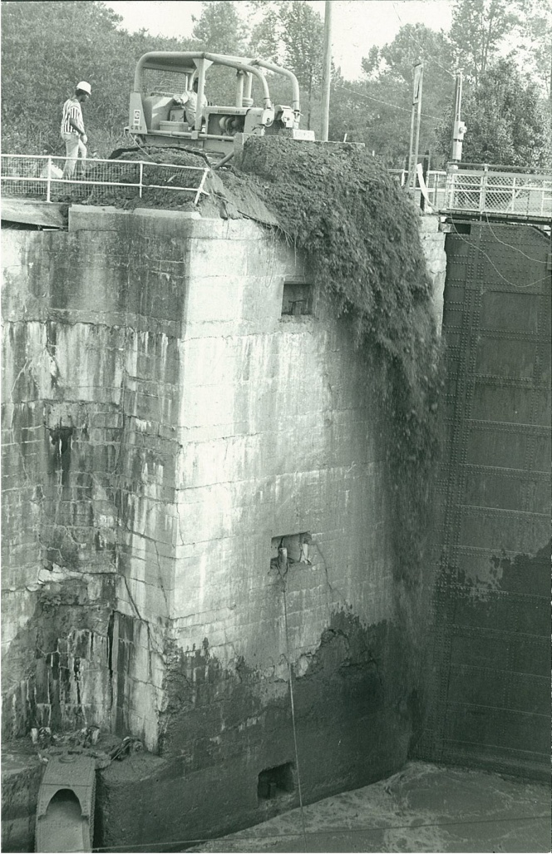
August 30, 1973
This August 30, 1973 photo shows the filling-in of the Lock chamber with tons of dirt.
Notes:
This August 30, 1973 photo shows the filling-in of the Lock chamber with tons of dirt on.

Slide 24
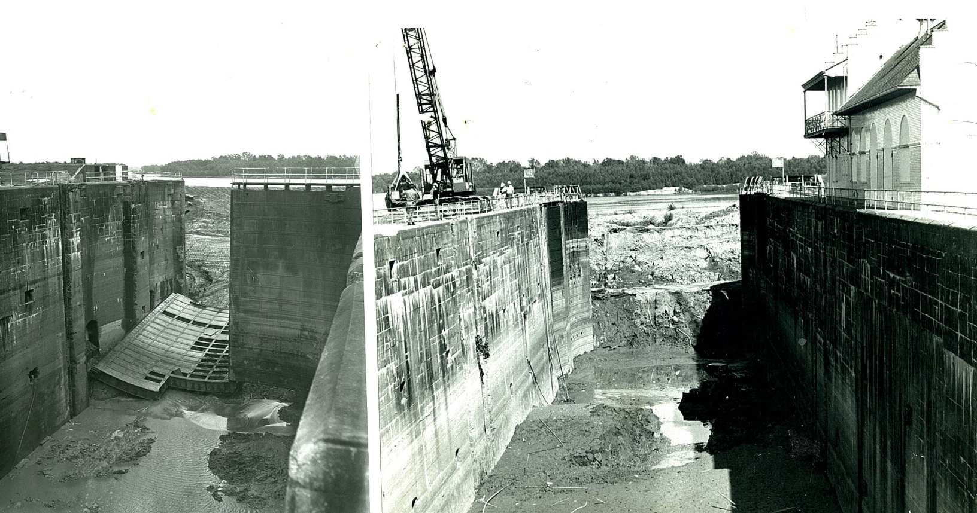
October 21, 1973
The opening of the Lock gates following the fill of dirt was accomplished by October, 1973. These photos show the huge Lock gate laying down, and the opening to the river end at right.
Notes:
The opening of the Lock gates following the fill of dirt was accomplished by October, 1973. These photos show the huge Lock gate laying down, and the opening to the river end at right.

Slide 25
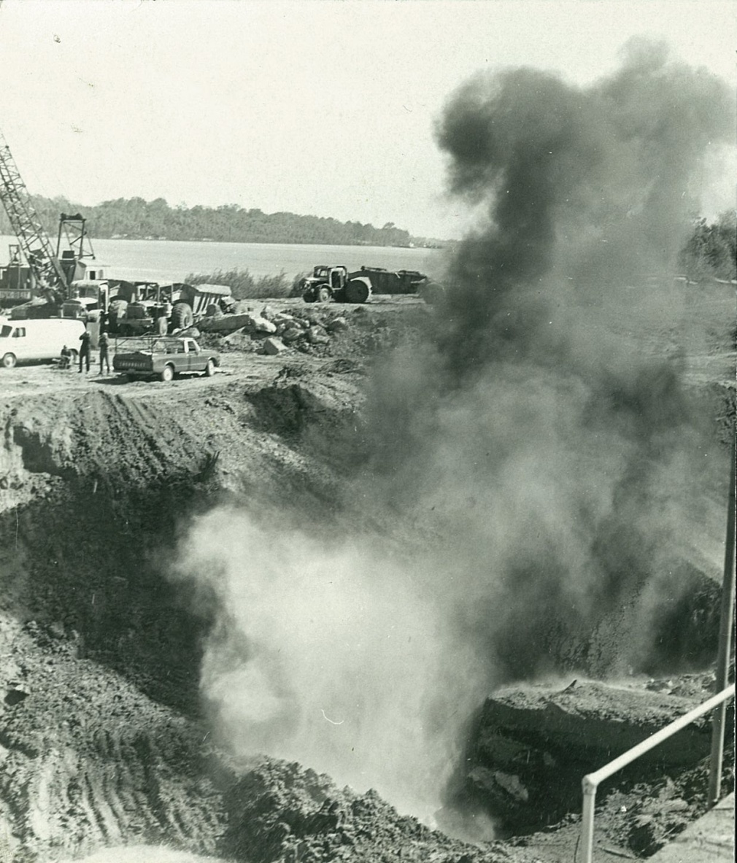
November 1, 1973
Bids for the permanent closure of the levee at the Bayou Plaquemine confluence with the Mississippi River site were received by the U.S. Army Corps of Engineers May 23, 1973. An earthen levee was constructed at the end of the Lock structure. Gates 1 and 2 were completely removed, and the levee was sloped back into the Lock chamber for some 190 feet. Dynamite was used to remove concrete on the river end of the Lock.
Notes:
Bids for the permanent closure of the levee at the Bayou Plaquemine confluence with the Mississippi River site were received by the U.S. Army Corps of Engineers May 23, 1973. An earthen levee was constructed at the end of the Lock structure, Gates 1 and 2 were completely removed, and the levee was sloped back into the Lock chamber for some 190 feet. Dynamite was used to remove concrete on the river end of the Lock.

Slide 26
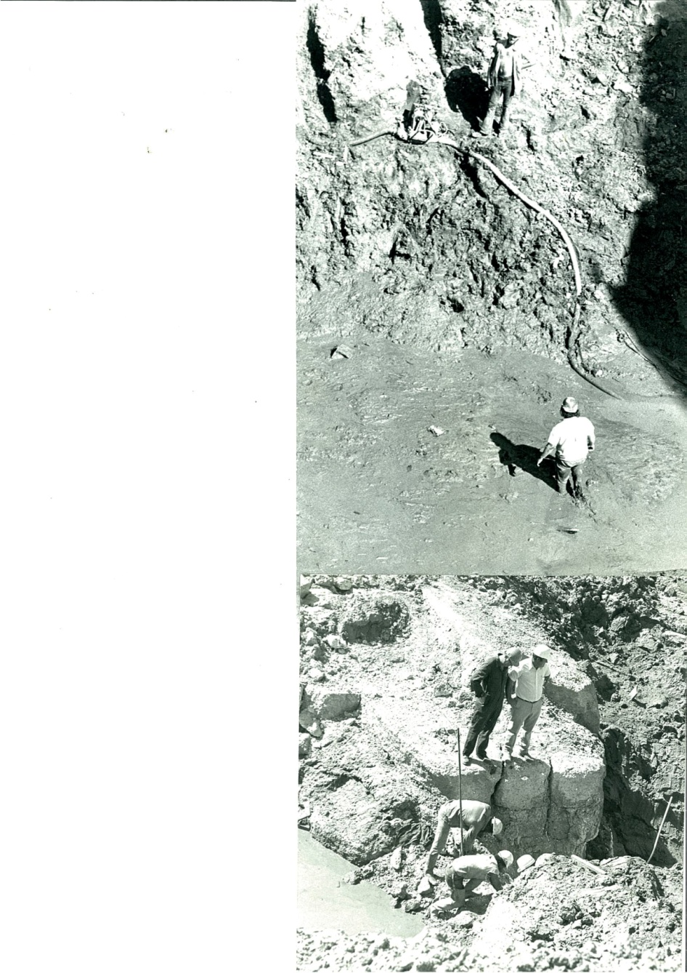
1973
Work on stabilizing the levee was a monumental task. Workmen are shown as the work progressed in 1973. The lower right photo shows the overgrowth of trees and brush on the river end.
Notes:
Work on stabilizing the levee was a monumental task. Workmen are shown as the work progressed in 1973. The lower right photo shows the overgrowth of trees and brush on the river end.

Slide 27
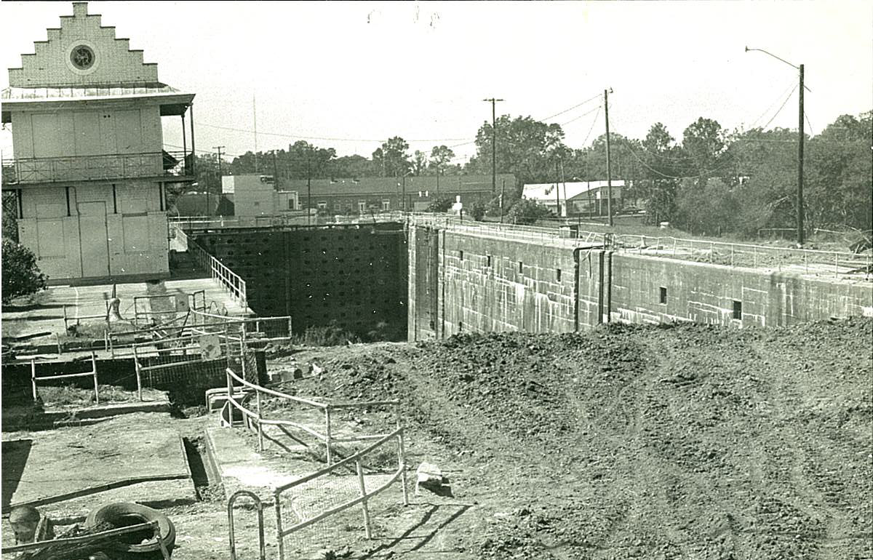
October 1974
This photo shows the continuation of the work as the earthen levee adjacent to the Lock was completed in October, 1974.
Notes:
This photo shows the continuation of the work as the earthen levee adjacent to the Lock was completed in October, 1974.

Slide 28
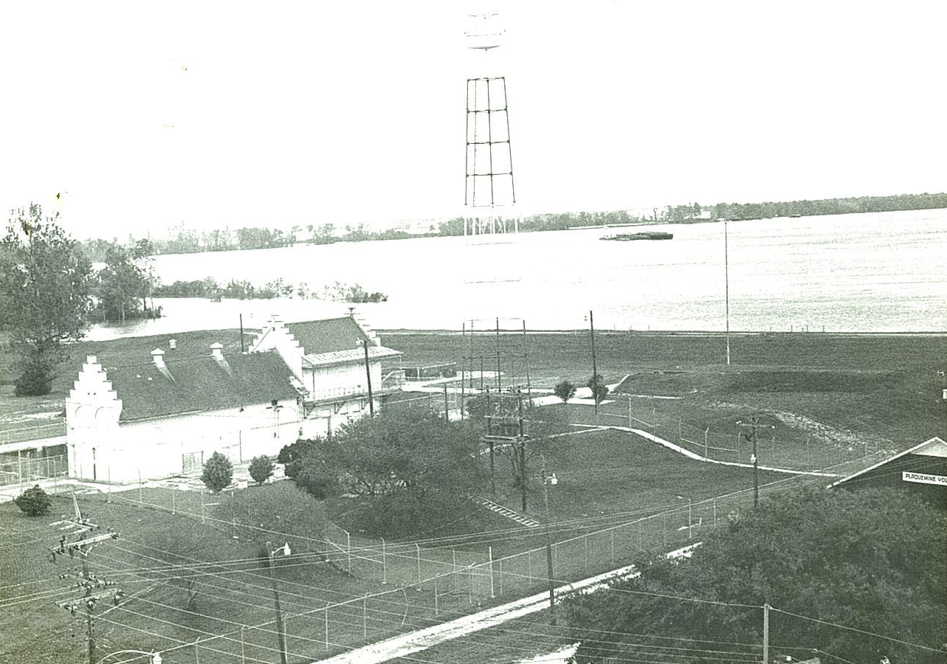
April 22, 1975
The Lock closure was complete and the Lockhouse was boarded up again in April, 1975, and remained boarded up until the 1980’s.
Notes:
The Lock closure was complete and the Lockhouse was boarded up again in April, 1975, and remained boarded up until the 1980’s.

Slide 29
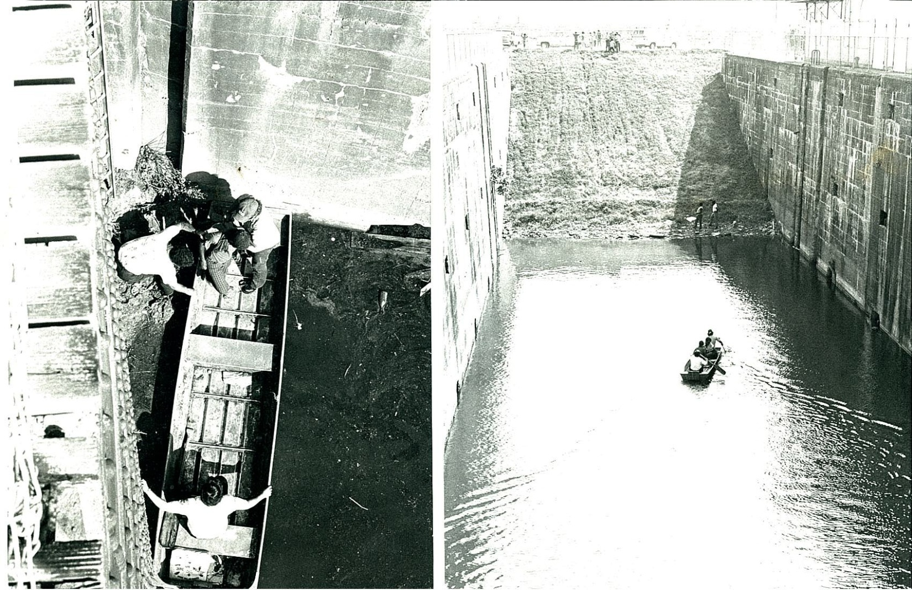
June 1975
This photo shows the earthen levee at the river end of the Lock when it was completed in 1975. Boaters still enjoy riding and fishing in the Bayou area, left.
Notes:
This photo shows the earthen levee at the river end of the Lock when it was completed in 1975. Boaters still enjoy riding and fishing in the Bayou area, left.

Slide 30
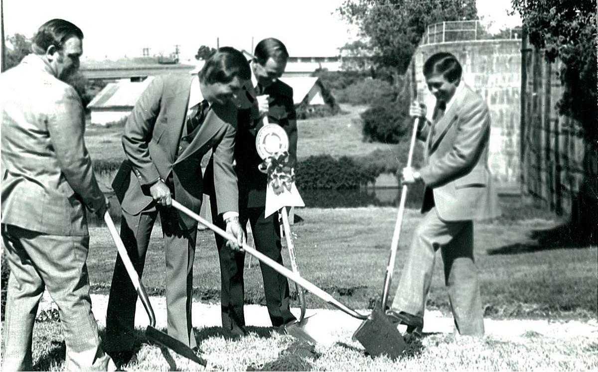
October 14, 1977
Ground-breaking ceremonies for the new highway through Plaquemine were held on October 14, 1977. In the photo are Mayor Stanley Hebert, State Senator J. E. Jumonville, Sidney Poleynard of the La. DOTD, and Representative Bobby Freeman.
Notes:
Ground-breaking ceremonies for the new highway through Plaquemine were held on October 14, 1977. In the photo are Mayor Stanley Hebert, State Senator J. E. Jumonville, Sidney Poleynard, assistant director of the Louisiana Department of Transportation and Development, and Representative Bobby Freeman.

Slide 31
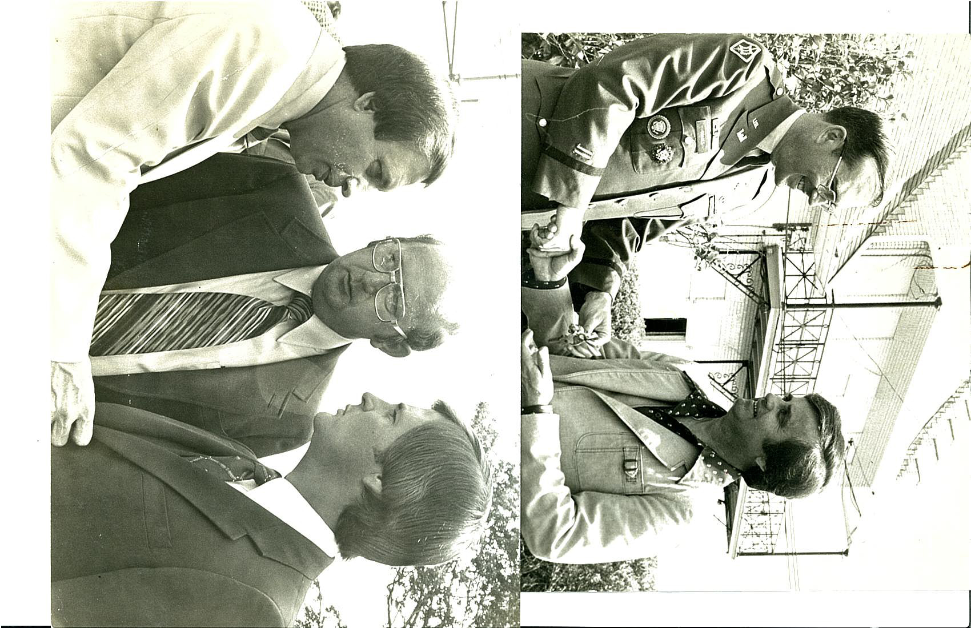
June 1978
The Plaquemine Lock was transferred from the U.S. Corps of Engineers to the State of Louisiana in June, 1978. At left Col. Charles Coates hands the keys to Dr. Larry Crain of the La. Department of Culture, Recreation and Tourism.
At right Gary Hebert, center, with Rep. Bobby Freeman and Senator J. E. Jumonville, Jr. at the groundbreaking for the Phase I development of the Plaquemine Lock State Commemorative Area and the renovation of the Lockhouse into a museum depicting the history of navigation on the Mississippi River.
Notes:
The Plaquemine Lock was transferred from the U.S. Army Corps of Engineers to the State of Louisiana in June, 1978. At left Col. Charles Coates hands the keys to Dr. Larry Crain of the Louisiana Department of Culture, Recreation and Tourism. At right Gary Hebert, center, is pictured with Rep. Bobby Freeman and Senator J. E. Jumonville, Jr. at the groundbreaking for the Phase I development of the Plaquemine Lock State Commemorative Area and the renovation of the Lockhouse into a museum depicting the history of navigation on the Mississippi River, the first of its kind in the state.

Slide 32
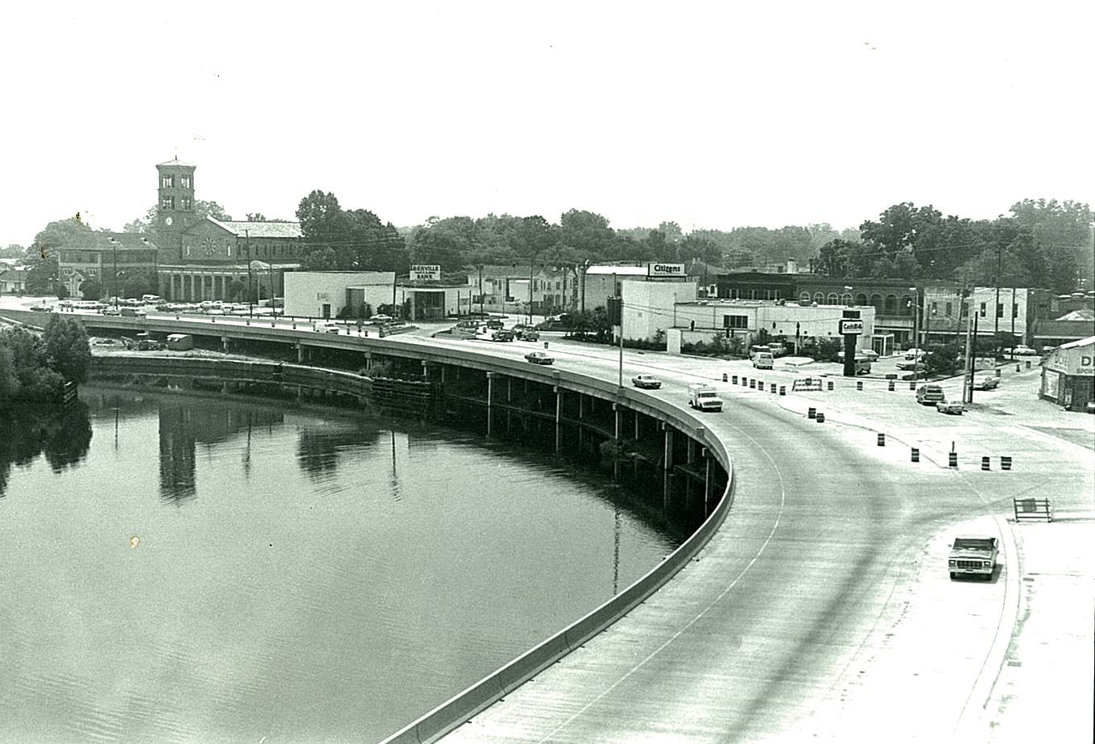
June 7, 1979
The new highway when it was completed in mid-1979.
Notes:
The new highway when it was completed in mid-1979.

Slide 33
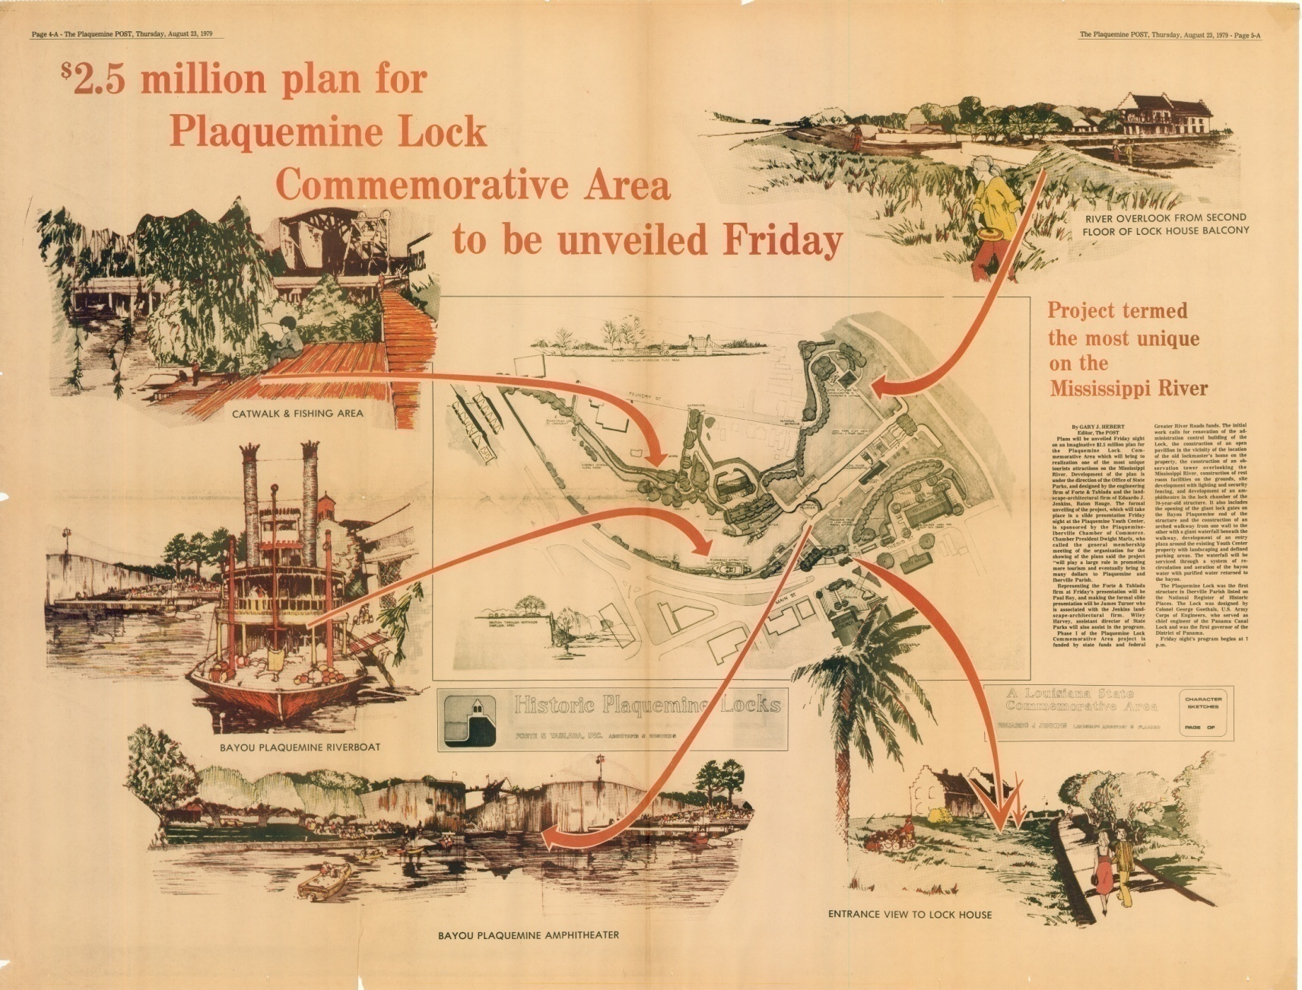
August 1979
The $2.5 million plan for the Plaquemine Lock State Commemorative Area was announced in 1979. A $1.476 million Great River Roads grant funded the project, which included the Lock museum, an interpretive pavilion, an observation tower, restroom facilities, parking areas and additional walkways.
Notes:
The $2.5 million plan for the Plaquemine Lock State Commemorative Area was announced in 1979. A $1,476,543 state and federal Great River Roads grant funded the project, which also included an interpretive pavilion, an observation tower, restroom facilities, parking areas and additional walkways.

Slide 34

A new day - the Plaquemine Lock State Commemorative Area opens.

Slide 35
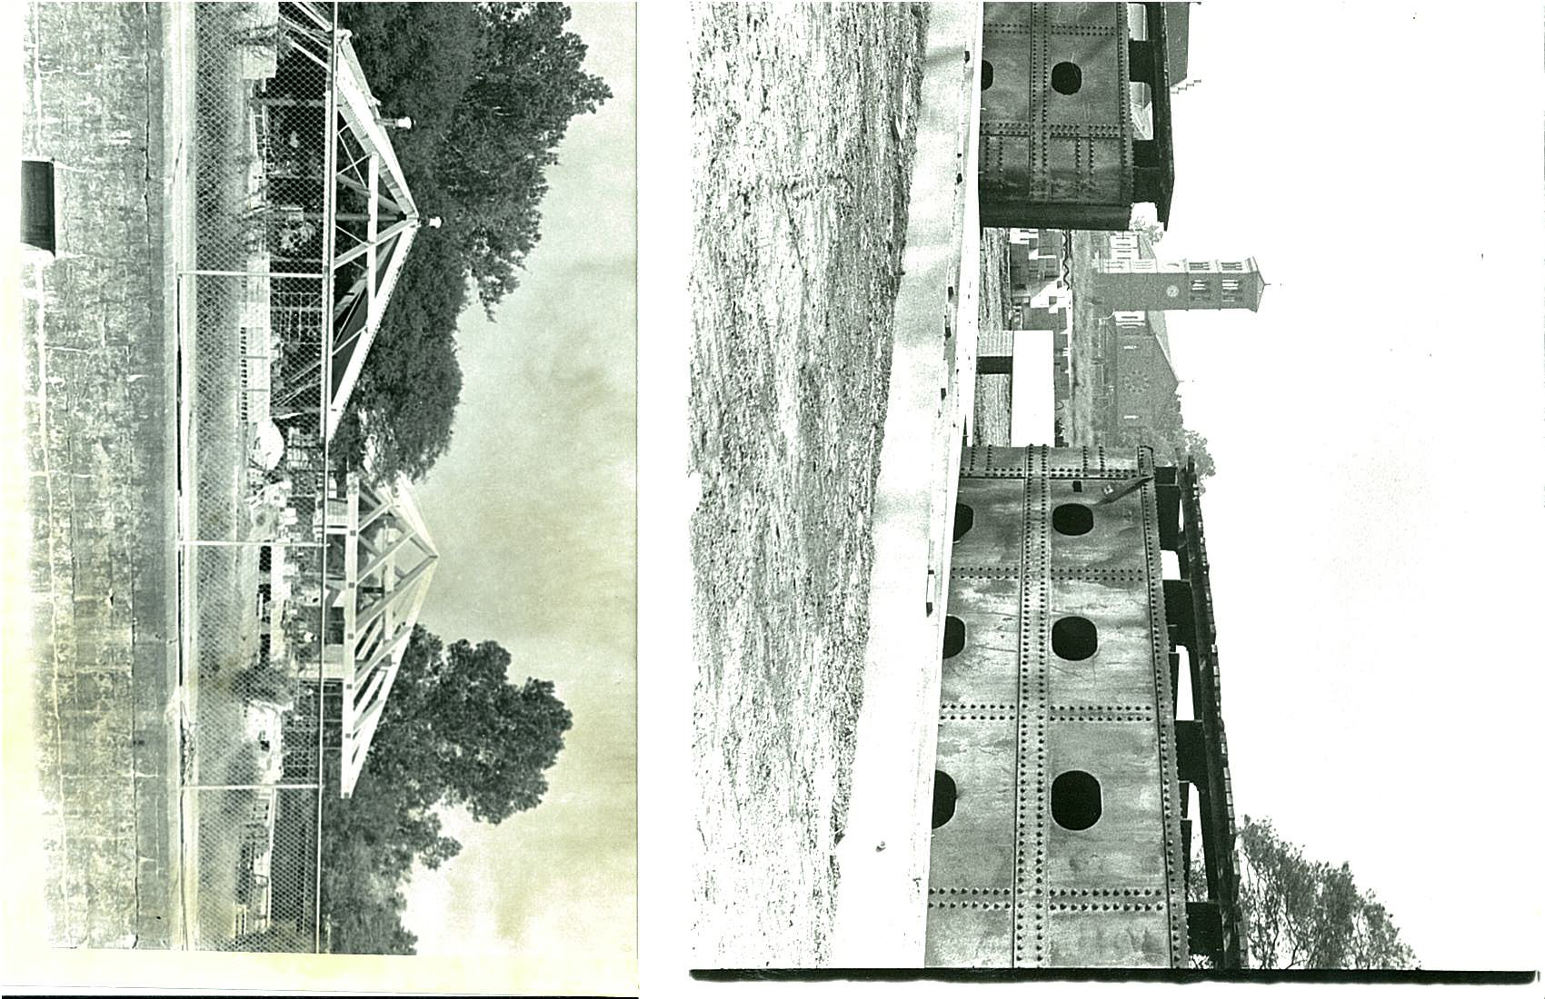
1980
Work on Phase I of the Plaquemine Lock State Commemorative Area showing the restrooms, the pavilion and the lock gates in place in 1980.
Notes:
Work on Phase I of the Plaquemine Lock State Commemorative Area showing the restrooms, the pavilion and the lock gates in place in 1980.

Slide 36
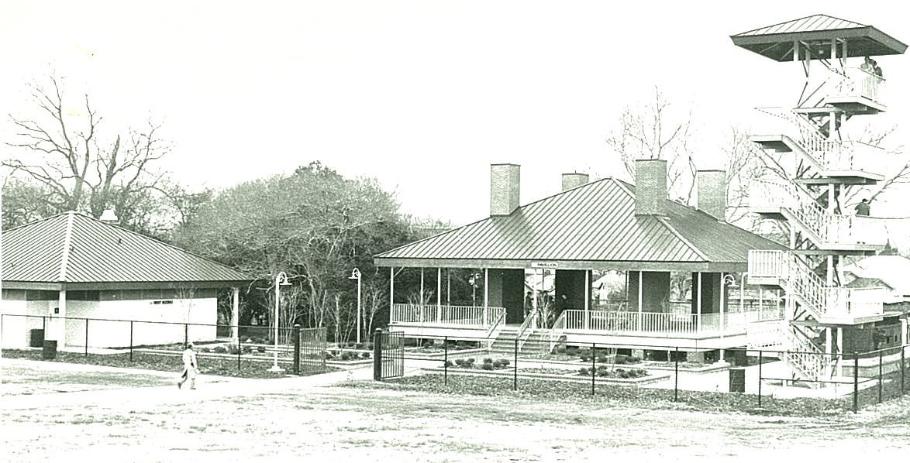
1982
Dedication ceremonies for the Phase I development of the Plaquemine Lock State Commemorative Area were held in February, 1982. The area was operated by the Department of Culture, Recreation and Tourism until 1988.
Notes:
Dedication ceremonies for the Phase I development of the Plaquemine Lock State Commemorative Area were held in February, 1982. The area was operated by the Department of Culture, Recreation and Tourism until 1988.

Slide 37
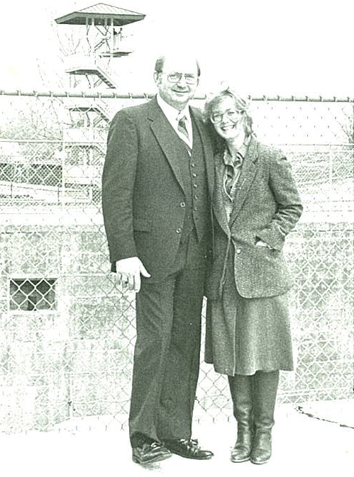
1982
Gary Hebert with Laura Landry, the first Park Manager. The Plaquemine Lock and other state commemorative areas were closed by the state due to insufficient funding by the legislature in 1988.
Notes:
Gary Hebert with Laura Landry, the first Park Manager. The Plaquemine Lock and other state commemorative areas were closed by the state due to insufficient funding by the legislature in 1988.

Slide 38
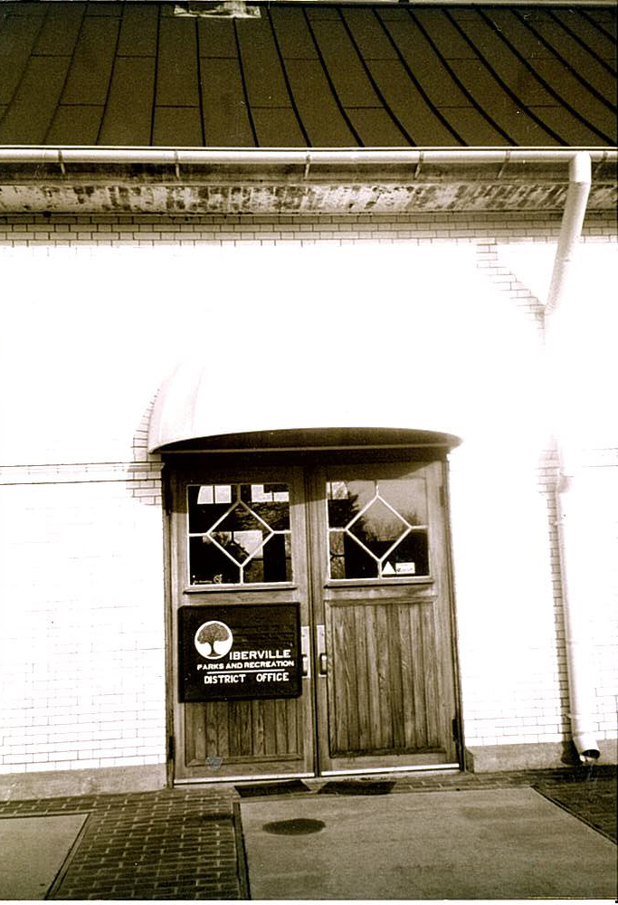
July 1989 – April 1992
Iberville Parks & Recreation housed its offices in the Lock Complex from July 1989 – April 1992. The Lock was boarded again up again April 1992 until July 1993.
Notes:
Iberville Parks and Recreation moved into the Lockhouse in July, 1989, and maintained it until April 1992. The IPRD also served as a tourist information center and conducted tours for visitors. The building was again vacant from April 1992 until July 1, 1993.

Slide 39
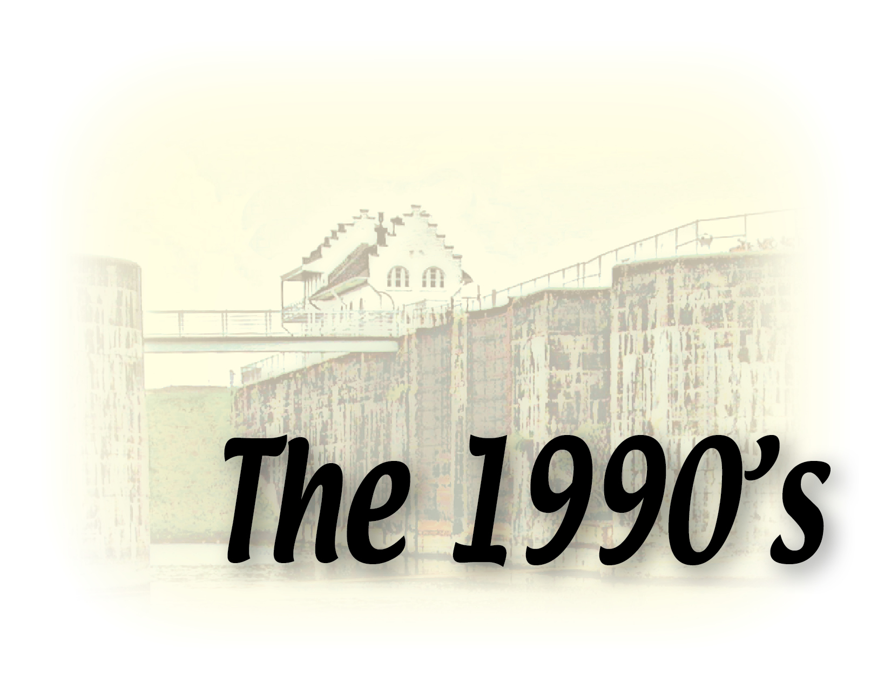
The Lockhouse is renamed the Gary J. Hebert Memorial Lockhouse.

Slide 40
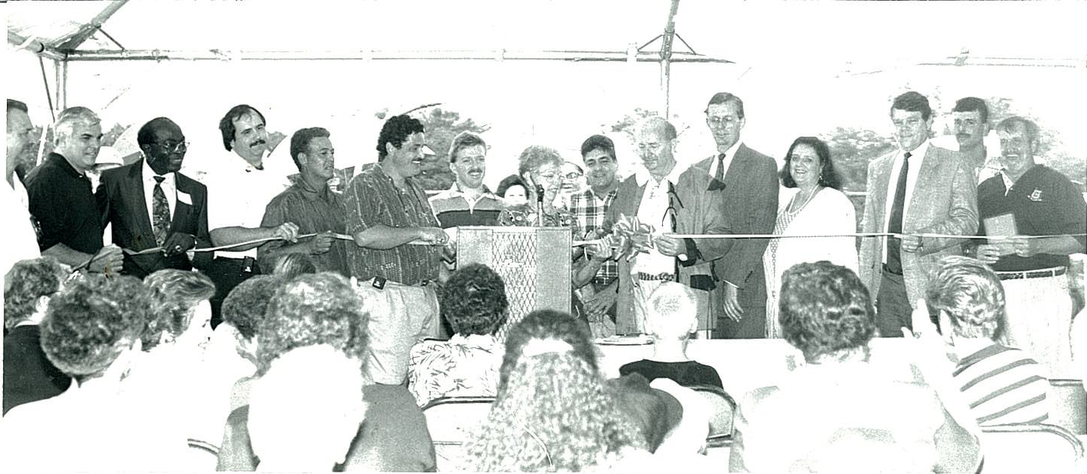
July 1, 1993
Ribbon cutting in July 1993 when the City Parish, Delta Jobs Corps & Iberville Chambers signed a lease with Office of State Parks to reopen the Lock.
Notes:
The City of Plaquemine signed a lease with the Office of State Parks to re-open the Plaquemine Lock State Commemorative Area July 1, 1993, and entered into agreements with the Iberville Parish Police Jury, the Delta Job Corps and the Iberville Chamber of Commerce to maintain the property, and keep it staffed as a museum and tourist information center.

Slide 41
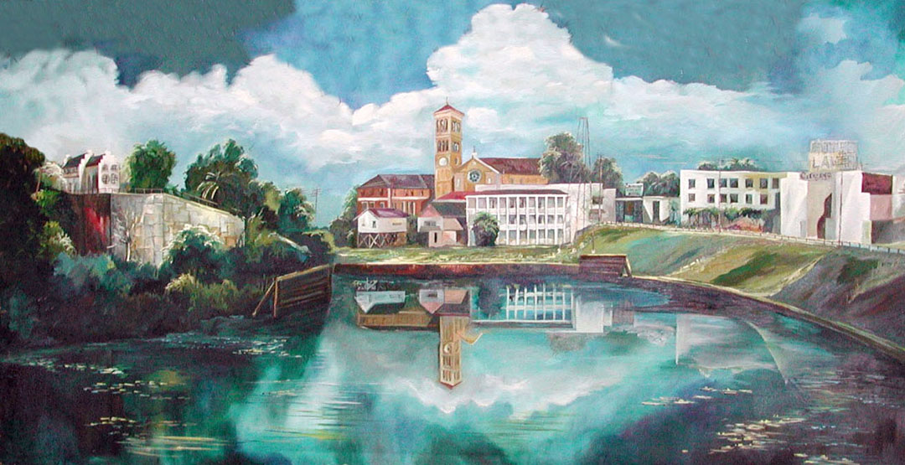
1993 – City of Plaquemine receives national grant for assessment of water resources and options for enhancement. Community meetings identify need to improve Bayou Plaquemine water quality and access to bayou. As a result, the City applied to be and was selected as a part of a U.S. Corps of Engineers pilot water restoration study of the waterway.
1995 – City purchases vacant property adjacent to Lock site for a park site from the now shuttered Nadler’s Foundry.

Slide 42
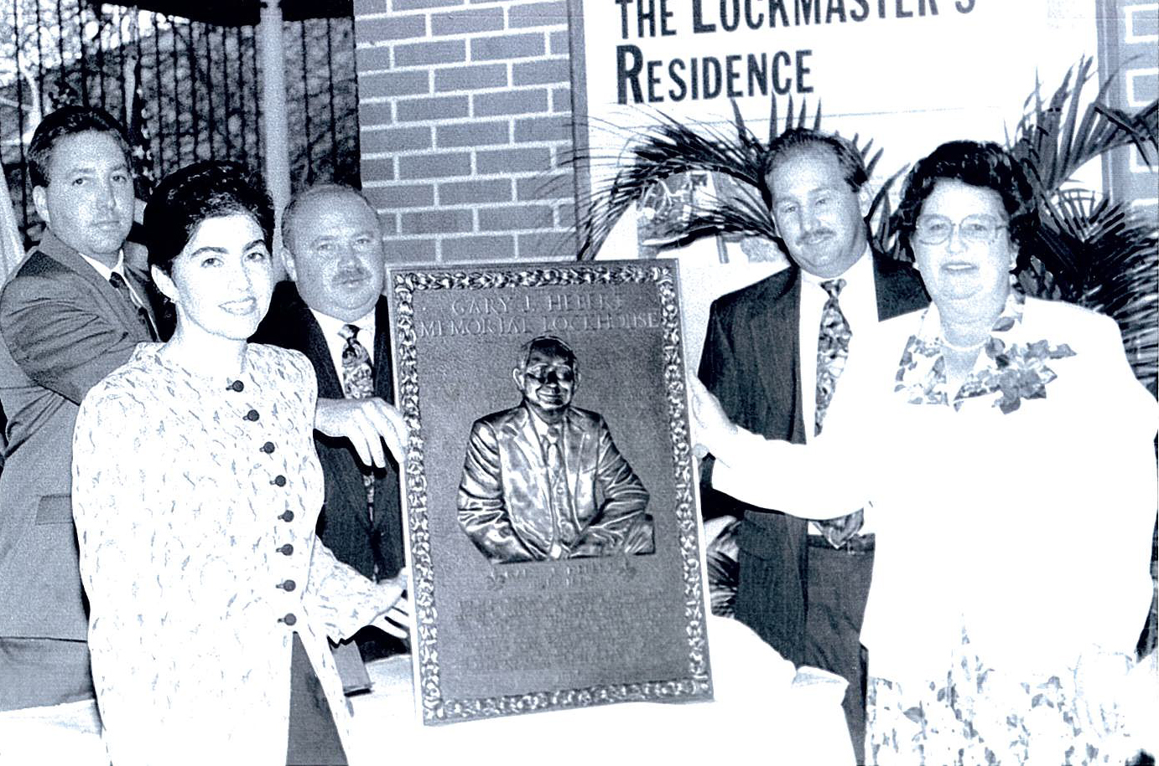
November 4, 1995
Lockhouse dedication ceremony re-naming it the Gary J. Hebert Memorial Lockhouse. Shown is the Hebert family.
Notes:
Following the death of Gary Hebert on August 29, 1994, Joyce Hebert and her family approached the City of Plaquemine, the Iberville Parish Police Jury and the Iberville Chamber of Commerce for resolutions endorsing the renaming of the Lockhouse to the Gary J. Hebert Memorial Lockhouse. Legislation was passed to rename the facility in the 1994 session of the legislature. Formal dedication ceremonies renaming the Lockhouse were held November 4, 1995. The Hebert family is pictured with the plaque marking the event. From left are John, Ellie, Gary Jr., Jerry and Joyce.

Slide 43
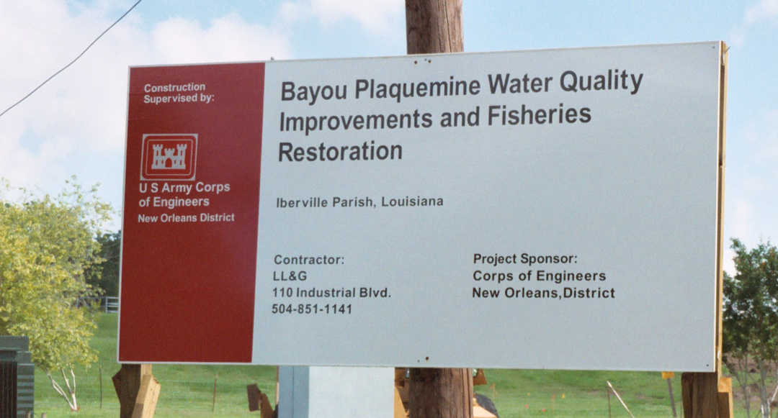
Sept. 1997 – Corps releases plan to restore Bayou Plaquemine. It includes installation of two 500-horsepower pumps with two 48-inch discharge pipes, pumping 60,000 gallons of water per minute from the Mississippi River into the Bayou Plaquemine Lock chamber. Cost: $3.6 million.
2001 – City and Corps begin feasibility study on water pump project, and pump design specifications.

Slide 44
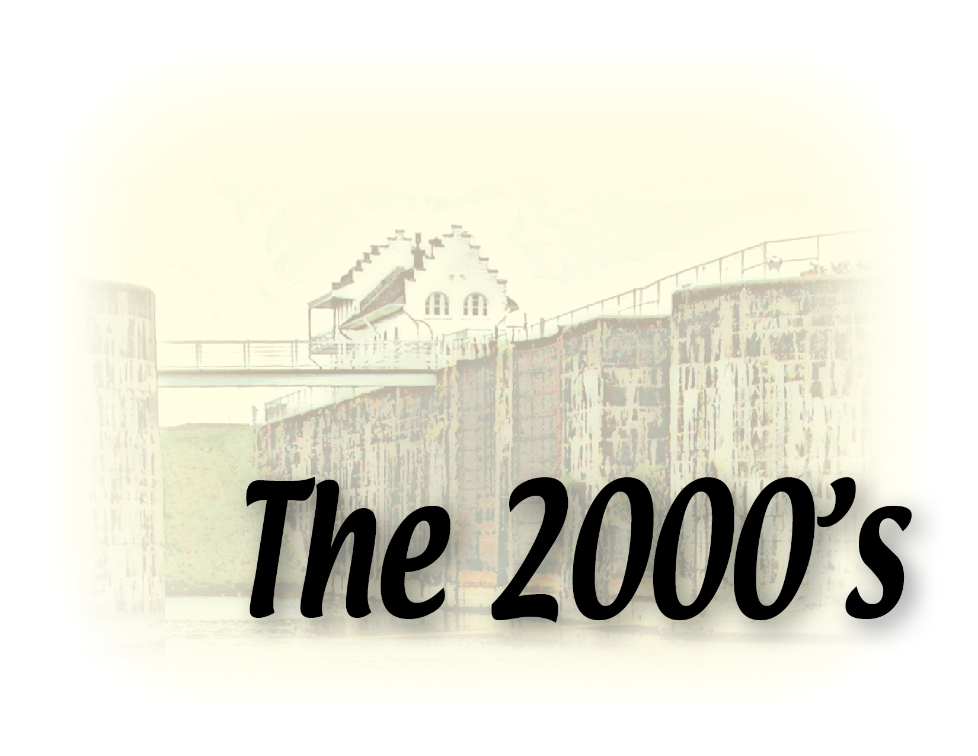
The Bayou Plaquemine Waterfront Park opens

Slide 45
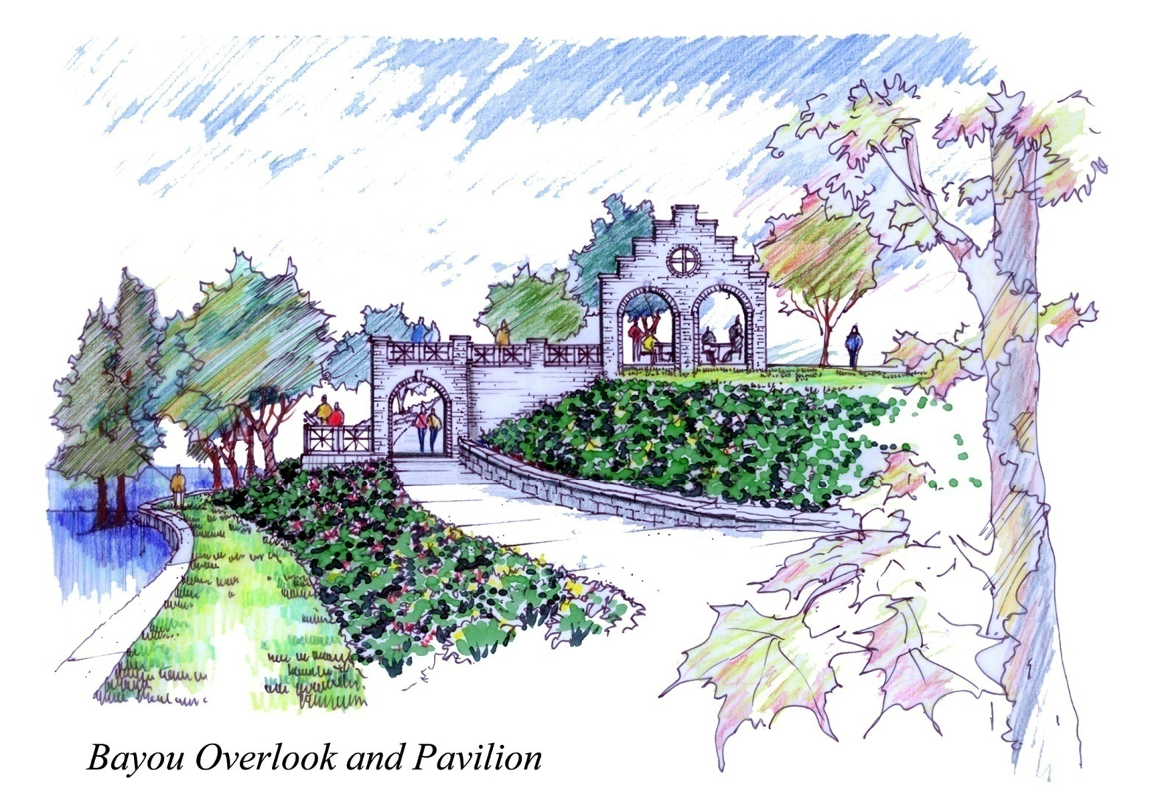
March 2000-2001
City designs and constructs phase one of Bayou Plaquemine Waterfront Park. It includes 1,100 square feet of wooden boardwalk, with a 1,200 square foot wooden pavilion and a smaller wooden pavilion over Bayou Plaquemine. The City obtained multiple sources of funding, grants and in-kind support for the $600,000 project.
Notes:
The City of Plaquemine, under the leadership of Mayor Tony Gulotta, received bids on Phase I of Bayou Plaquemine Waterfront Park in March 2000. Phase I included a walkway and a boardwalk along the bayou bank. Bids came in at $241,000. Tony had the foresight and the imagination to see how beautiful this area, the heart of Plaquemine, could be. He has worked tirelessly for years to see these projects to completion. The initial effort began in 1994 when Mayor Gulotta and Council Members visited the River Walk in San Antonio.

Slide 46
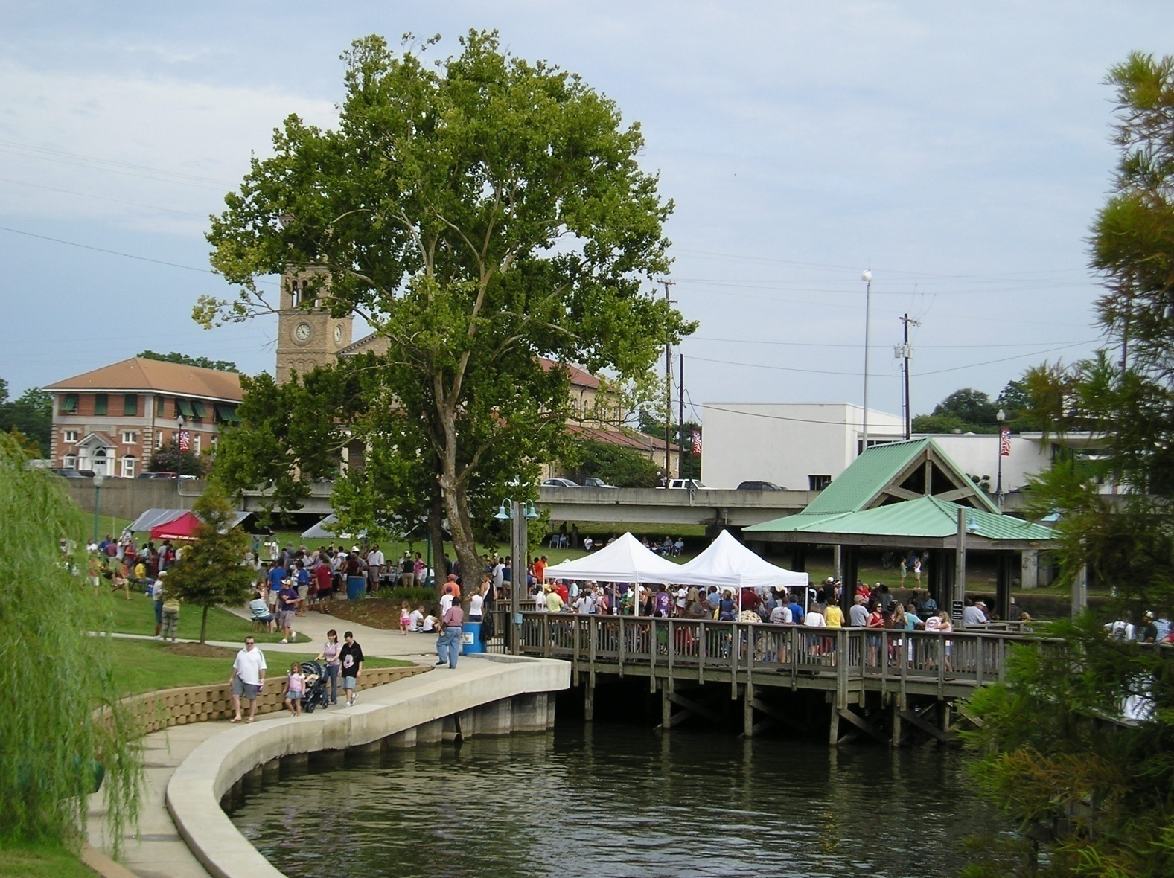
July 4, 2001
First July 4th celebration
Notes:
The first Plaquemine July 4th Celebration was held at the Bayou Plaquemine Waterfront Park in 2001. The successful event, which draws thousands to the area, observed its 10th anniversary this year.

Slide 47
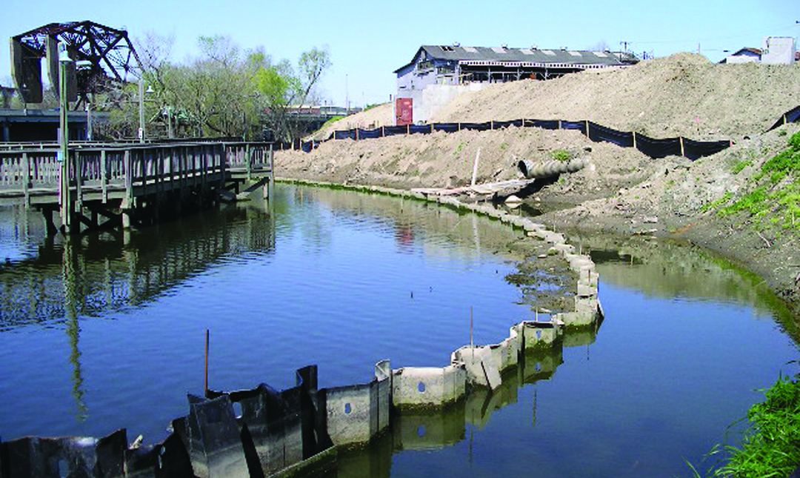
Community meetings held for master planning of park. Master plan includes the pavilions, picnic areas, seating, lighted walkways, floating docks for boat access to the park, a huge multi-use pavilion and parking, to be constructed in three phases, with phase I already completed.
2002

Slide 48
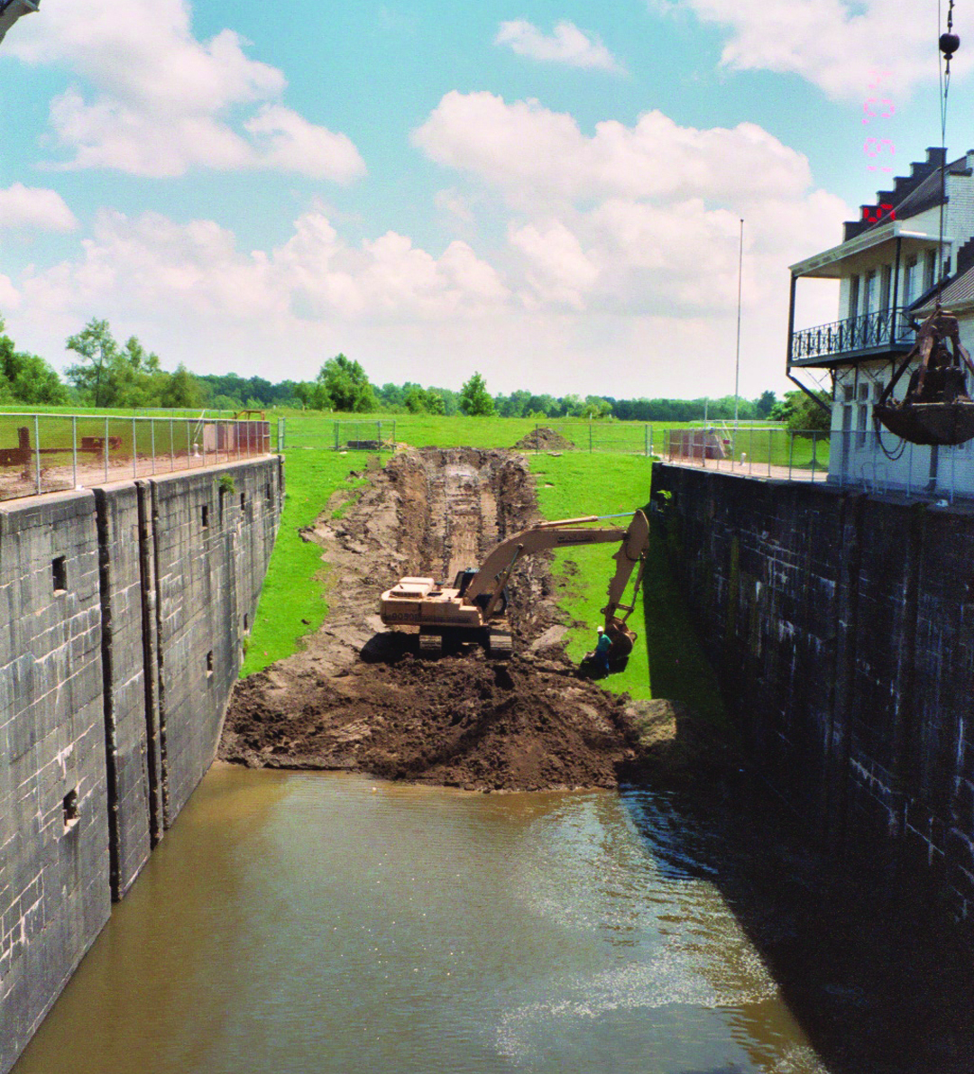
²⁰⁰³
Co-Op project agreement signed by City and Corps for pump construction
March, 2004 Water pump project begins. The pump
^{project had} been delayed by high water in the Mississippi River, slow delivery of the pumps, and hurricanes.

Slide 49
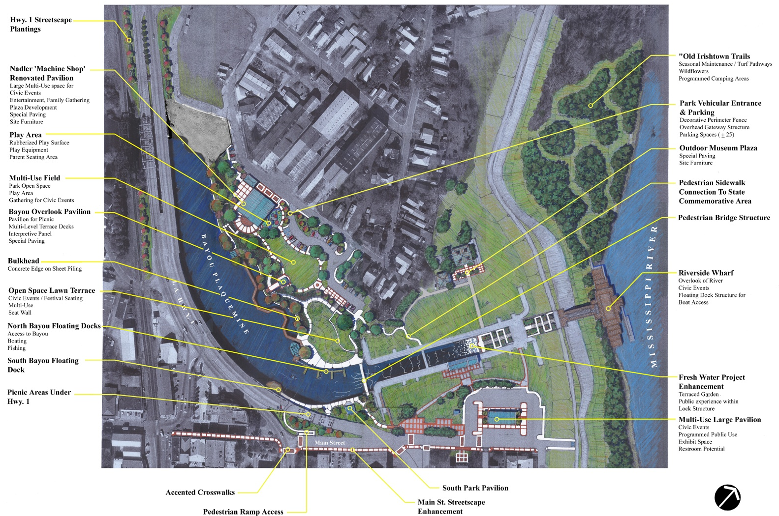
2006
Master plan of Bayou Plaquemine Waterfront Park – includes pavilions, picnic areas, seating, lighted walkways, floating docks for boat access to the park, a huge multi-use pavilion and parking.
Notes:
Phase II of Bayou Plaquemine Waterfront Park included a pavilion, an overlook, parking, landscaping and floating piers. Dedication ceremonies for Phase II were held June 20, 2006. First Lady of Plaquemine, Mary Sue Gulotta, shattered a bottle of champagne on the cement pillar adjacent to the pier of Bayou Plaquemine to mark the official opening. On April 10, 2003, Mayor Gulotta signed a preliminary agreement with the U.S. Army Corps of Engineers to begin construction of the $3.54 Million pumps to introduce fresh water from the Mississippi River into Bayou Plaquemine for the first time in decades. The pumps were installed in March 2007, only to be pulled for repair after 300 hours of use. They were reinstalled in February 2008 and pulled again, and reinstalled in June 2008. They are now providing fresh water into Bayou Plaquemine.

Slide 50
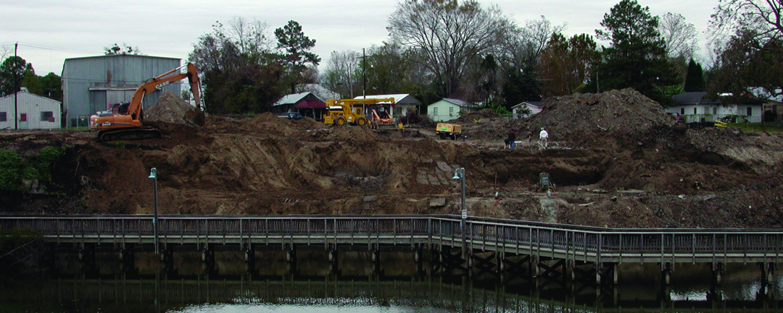
April 2004 – Construction begins on Phase II of Waterfront Park, which includes the overlook pavilion, sidewalks, parking, dirt work and extensive landscaping. The City obtained a $1 million grant from the Atchafalaya Basin Program to pay for part of Phase II of the park.
December 2004 – Additional land purchased from Nadler’s Foundry for Phase III of Waterfront Park.

Slide 51
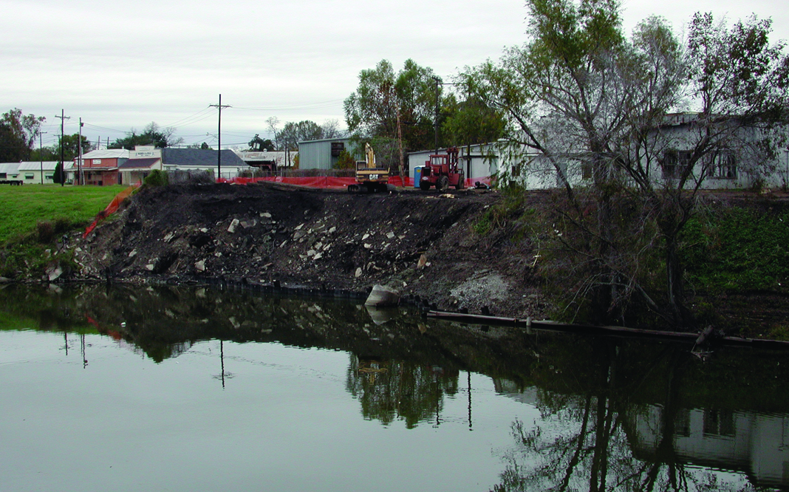
^{March 2006}
The La. Department of Wildlife and Fisheries assists with restocking the bayou with Florida Bass fingerlings to improve the aquatic habitat, and agrees to monitor the bayou and pumping schedule for three years.
^{More phase II construction}

Slide 52
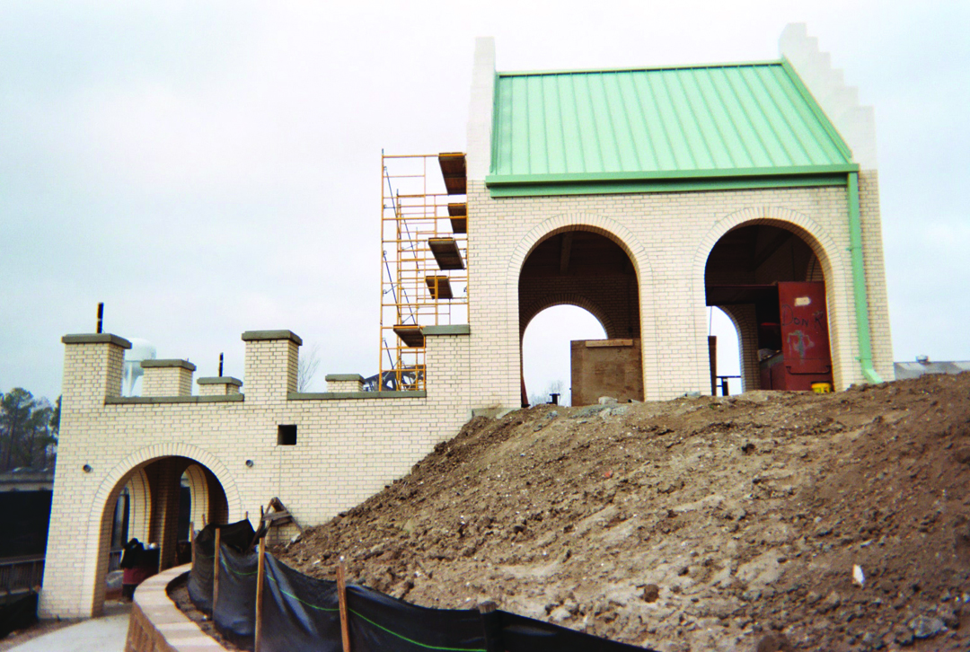
Phase II construction

Slide 53


June 2006 – Ribbon cutting ceremony held for the completion of phases I and II of the park, the floating dock, and the fresh water pump project.
Shown at ribbon-cutting are Mayor Mark “Tony” Gulotta, with Sandra Thompson of the Atchafalaya Program, Will Hinson of Georgia Gulf Corp., and Donna Carville of the Dow Chemical Co. All provided grants to the park construction.

Slide 54

²⁰¹⁰
After working years to obtain grants and funding, the City begins construction of Phase III of the Bayou Plaquemine Waterfront Park – the development of the northern section with a 10,000 square foot open-air pavilion, meeting room, kitchen, bathrooms and parking.

Slide 55

Old Nadler Building before pavilion construction

Slide 56

Pavilion construction

Slide 57

Pavilion construction

Slide 58

January 21, 2011
The Louisiana Department of Culture, Recreation and Tourism ended the lease with local government agencies and took over the operation of the Lock on January 1, 1999. The state operated the Lock as a tourist center until July 1, 2010 when, due to state budget cuts, the staff was slashed and the facility was open to scheduled groups only. Plaquemine Mayor Tony Gulotta and Iberville Parish President Mitchell Ourso stepped up to form a cooperative endeavor agreement with the state, to reopen the facility. It was only with their help that the Lock now remains open full-time. The City of Plaquemine and the Iberville Parish Council provide many services to the Lock including utilities, maintenance and upkeep. The Friends of the Lock was organized January 1, 2011 to assist with tours and the upkeep of the Lock. Re-opening ceremonies were held January 21, 2011. At that time elected officials and the Friends pledged that the Lock and Lockhouse will not close again.
Reopening of the Lock
Notes:
The Louisiana Department of Culture, Recreation and Tourism ended the lease with local government agencies and took over the operation of the Lock on January 1, 1999. The state operated the Lock as a tourist center until July 1, 2010 when, due to state budget cuts, the staff was slashed and the facility was open to scheduled groups only. Plaquemine Mayor Tony Gulotta and Iberville Parish President Mitchell Ourso stepped up to form a cooperative endeavor agreement with the state, to reopen the facility. It was only with their help that the Lock now remains open full-time. The City of Plaquemine and the Iberville Parish Council provide many services to the Lock including utilities, maintenance and upkeep. The Friends of the Lock was organized January 1, 2011 to assist with tours and the upkeep of the Lock. Re-opening ceremonies were held January 21, 2011. At that time elected officials and the Friends pledged that the Lock and Lockhouse will not close again.

Slide 59

2011 – Second set of floating docks installed on the south side of the Park. This $150,000 project was funded through Louisiana Recreational Trails.

Slide 60

December, 2011 – Phase III of the Park is completed.
March, 2012 – Grand Opening Extravaganza is held for the
community to commemorate completion of Phase III of the Bayou Plaquemine Waterfront Park.

Slide 61

If you build it, they will come… tourists visiting via jet skis

Slide 62

St. Jude Car Show

Slide 63

July 4th Celebration

Slide 64

Park Awards
Louisiana Municipal Association – Community Achievement Award – Best of Show, 2006
Louisiana Wildlife Federation – Mayor Mark A. “Tony” Gulotta – 2006 Conservationist of Year in the Elected Official Category in the 43rd Annual Governor’s Conservation Achievement Recognition Program
Louisiana Trust for Historic Preservation – Mayor Mark A. “Tony” Gulotta –
^{2009 Elected Official of Year}
American Society of Landscape Architects, Louisiana Chapter - Community Planning Award in the 24th Annual Professional Design Awards Program, 2007

Slide 65


Slide 66


Slide 67


Slide 68


